Slide 1
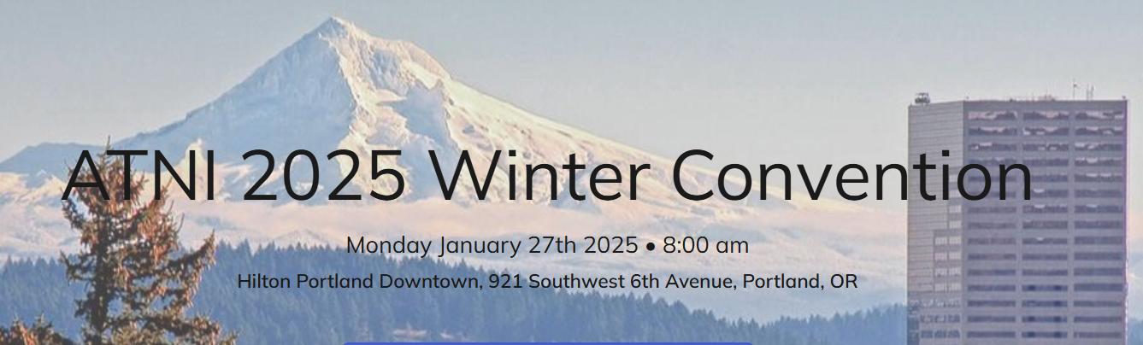
Doug Howell
NGO Consultant on Transmission
DougHowellTx@gmail.com
Notes:
Thank you for the opportunity to participate in this session.
Congratulations to ATNI for the resolution on transmission and energy markets
My name is Doug Howell and I am consultant to Non-Government Organizations, mostly climate and environmental groups
My focus is on transmission.
I am here today to share with Northwest tribes the strong likely of big new transmission lines are coming.
The most prominent of those lines is the Montana to Washington and Oregon line that will pass through Idaho.
My hope is that tribes will be engaged before private developers, utilities or the Bonneville Power Administration begin design work which will determine the route
Rather it is our hope that Northwest Tribes will determine the route.
Better yet, perhaps Northwest Tribes can use this as an opportunity ensure their renewable energy projects get in the grid
Better yet, perhaps Northwest Tribes can be owners of the transmission line

Slide 2
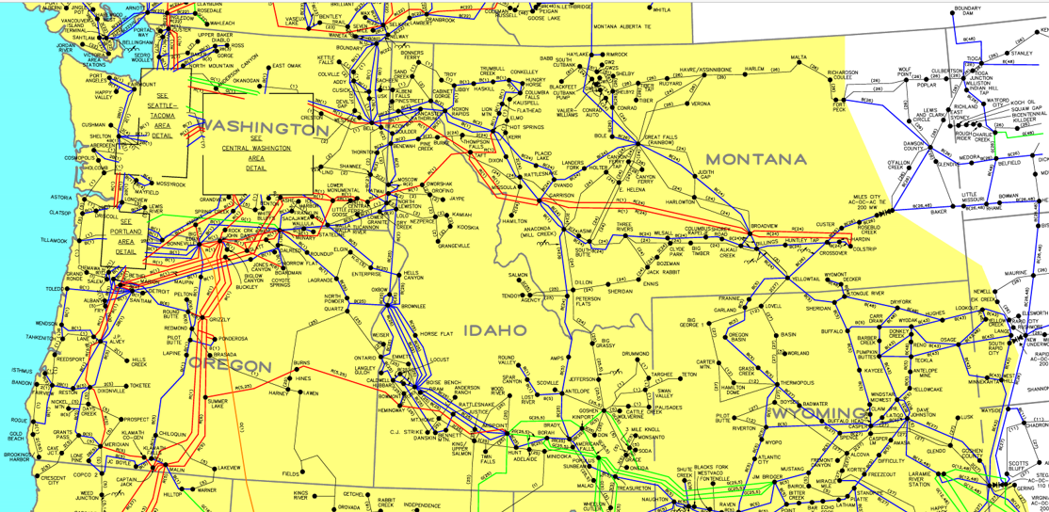
WECC-Map-of-Principal-Transmission-Lines.pdf
Notes:
I would like to share why we believe more transmission is essential.
Load growth: vehicles, buildings, data centers, manufacturing
Data Center 1,000 to 5,000 MW byt the early 2030s just for Northwest public utilities
Over 100,000 megawatts of developable wind in Montana
The strongest capacity factors in the Northwest – Gorge = 33%, MT = 30 to 70 percent
Montana wind peaks in winter when our wind and solar are at low output yet it is when we have the highest demand for electricity
All of our major utilities in the regiona have recognized Montana wind as an essential resource in their long-range plans
Electricity is the key to ending global warming in the Northwest
Montana wind is the single most powerful resource to achieve that result
Transmission studies confirm this need.
1. Connected West was first major 20-year transmission blueprint for the West and Montana to Washington was a major corridor
2. The Bonneville Power Administration validated this pathway in its 2024 “Cluster Study” on transmission needs.
3. Grid United and Northwestern Energy are currently evaluating the Montana to Idaho pathway, which would connect to pathways headed West
4. The five major utilities that own Colstrip Montana coal plant now have MOUs with Grid United on the Montana-based North Plains Connector transmission line that heads East, yet they do not have comparable capacity to bring that transmission West into their service territories, thereby further validating the need for more Montana to Washington/Oregon transmission capacity.
Environmental groups actively want to support this line but only if tribes are engaged in the front-end of the process
If you would like to be kept informed about progress or developments, please let me know.

