Slide 1


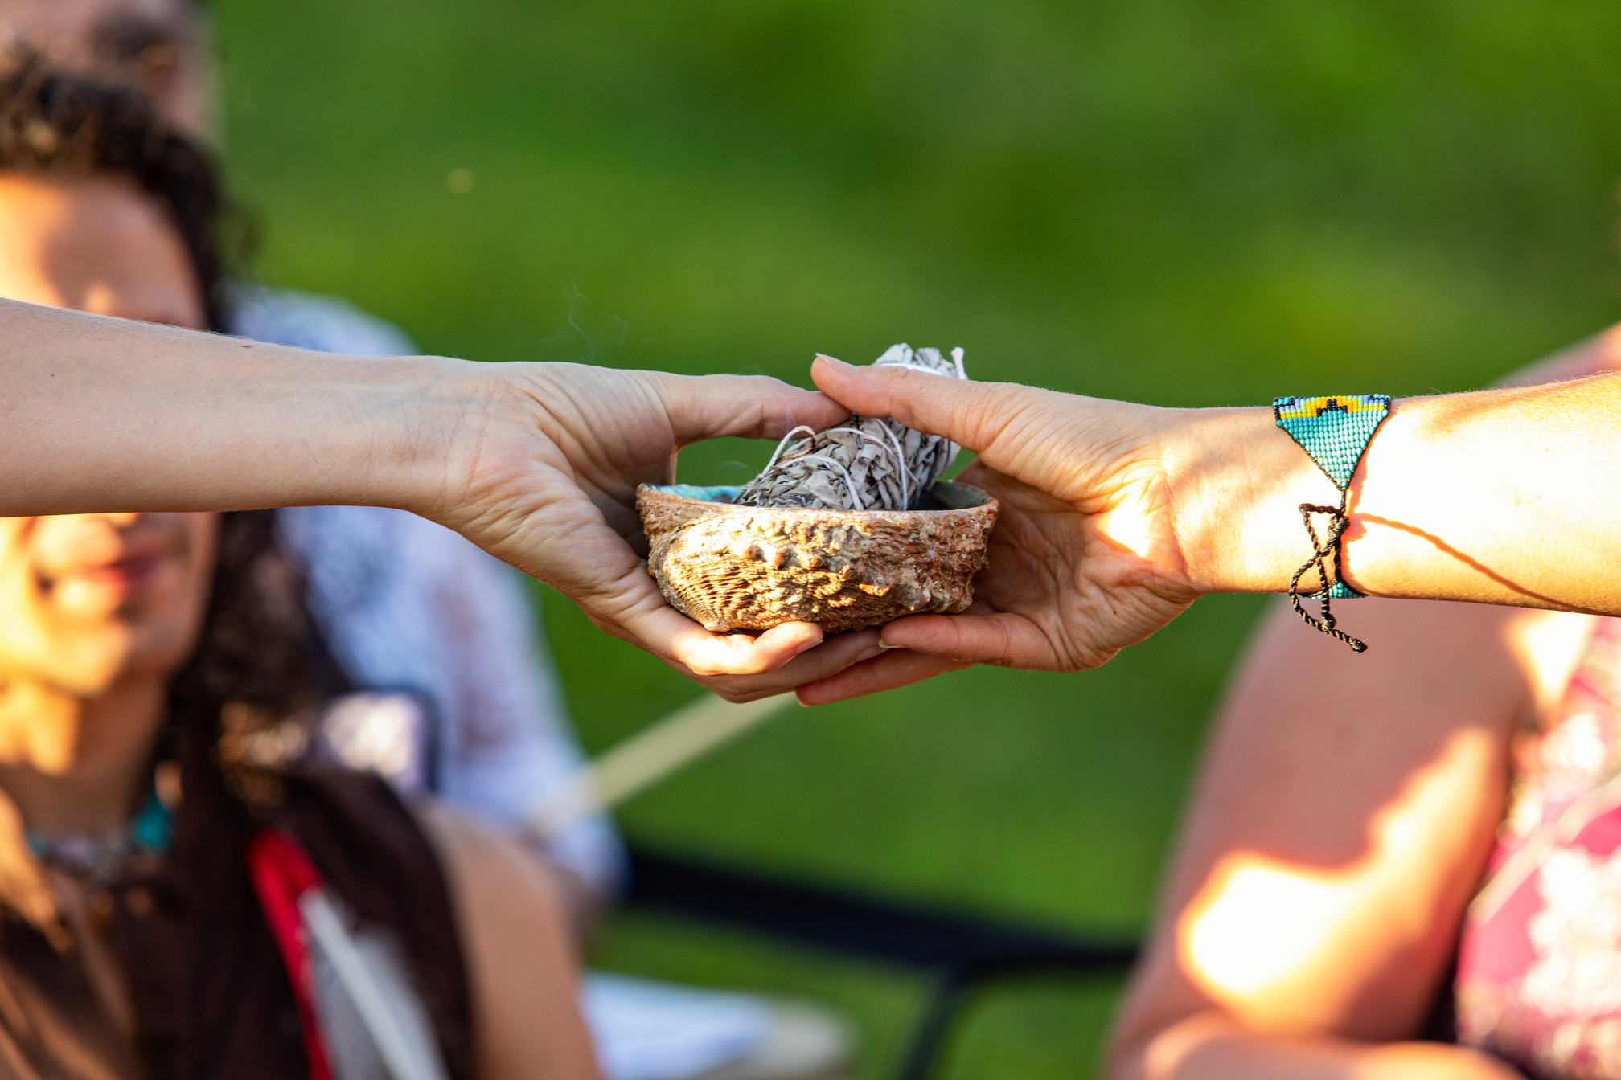

Washington State Tribal Prevention System (WSTPS) -
North Star
ATNI 2025 Winter Convention
January 28, 2025

Slide 2

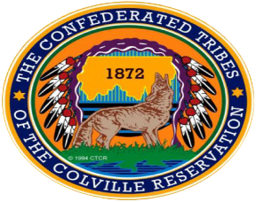





WSTPS - North Star Pilot Tribes
Confederated Tribes of the Colville Reservation
Jamestown S’Klallam Tribe
Lummi Nation
Swinomish Indian Tribal Community
Tulalip Tribes

Slide 3



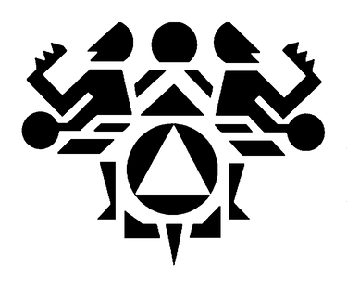

WSTPS - North Star Partners
Centers for Disease Control and Prevention
Office of the Governor of Washington State
Northwest Portland Area Indian Health Board
Washington State Health Care Authority

Slide 4
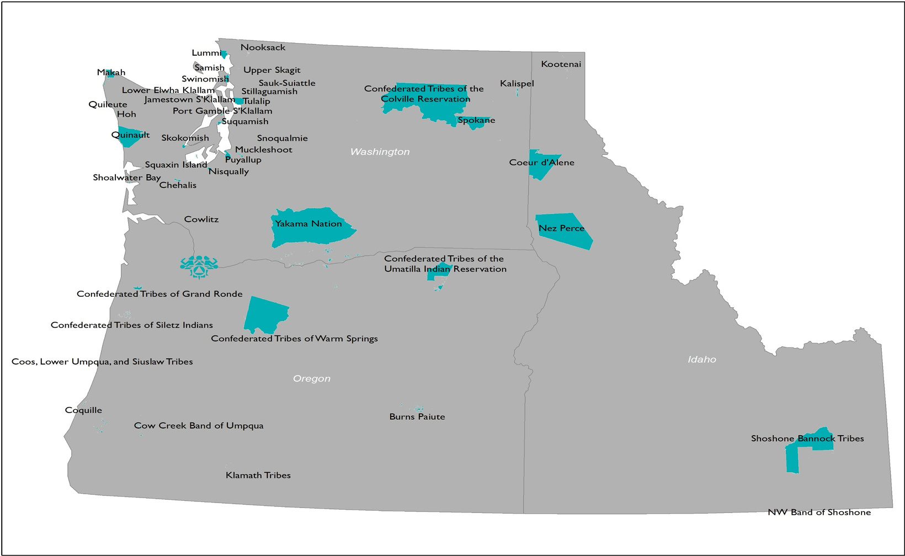
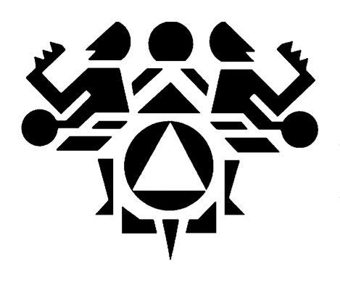
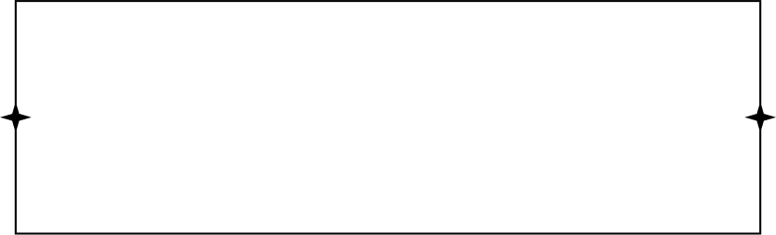
Northwest Portland Area Indian Health Board
  Tribal Advisory Organization
  Tribal Delegation
  1 of 12 Tribal Epidemiology Centers
  Health Promotion & Diseases Prevention
  Legislative & Policy Analysis
  Training & Technical Assistance

Slide 5





Icelandic Prevention Model
Upstream activities to prevent problems before they occur
Happier, Healthier children
Happier, Healthier adults
Happier, Healthier society
IMPACT ON CHILDREN
IMPACT ON ADULTS
IMPACT ON SOCIETY
UPSTREAM

Slide 6
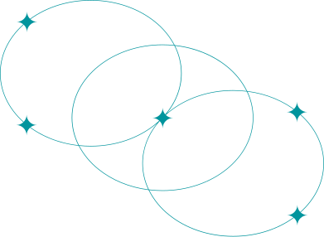




Icelandic Prevention Model (IPM)
Parents/Family:
  Support - Care and warmth, discussing personal matters
  Supervision - Spending time with family and friends, knowing friends and their parents
FAMILY
LEISURE TIME
PEER GROUP
School: Well-being at school, having friends, feeling safe, having an adult to talk to, and communicating
SCHOOL
Leisure Time: Participation in organized recreational and sports activities
Peer Group: Having friends - belonging - community

Slide 7
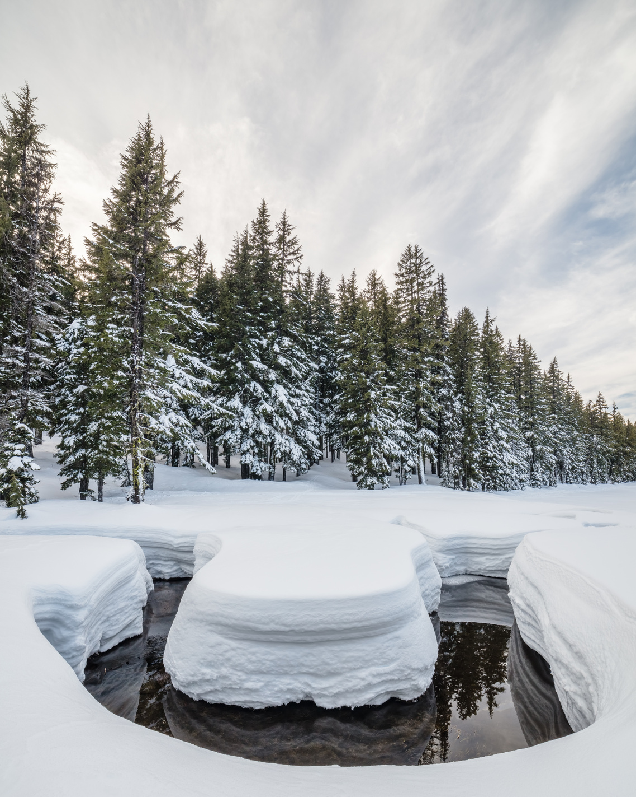
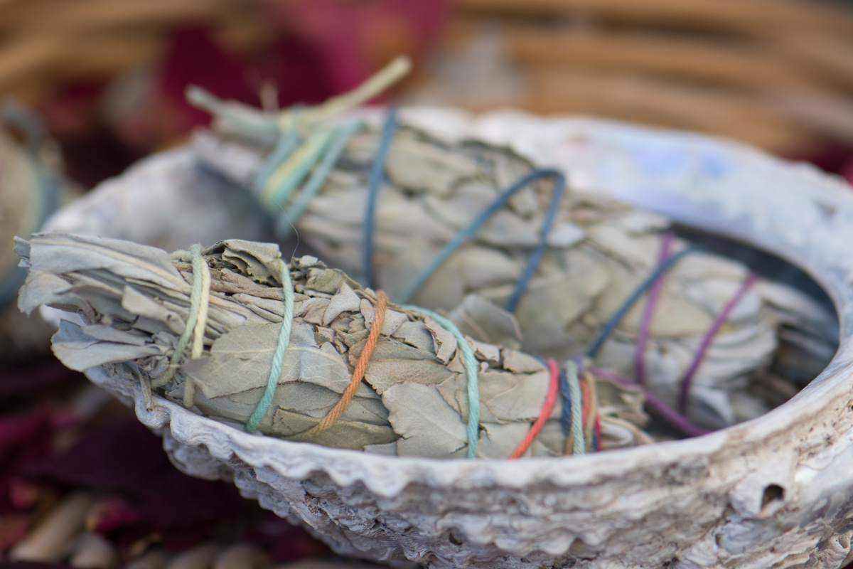
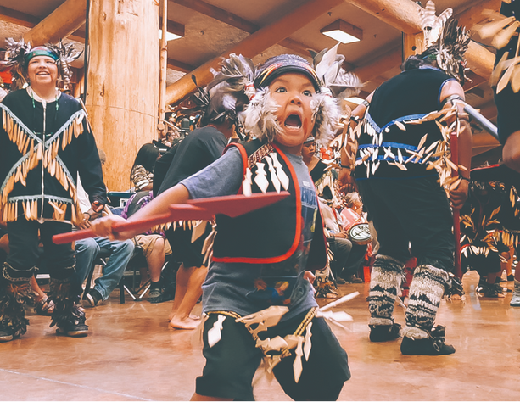
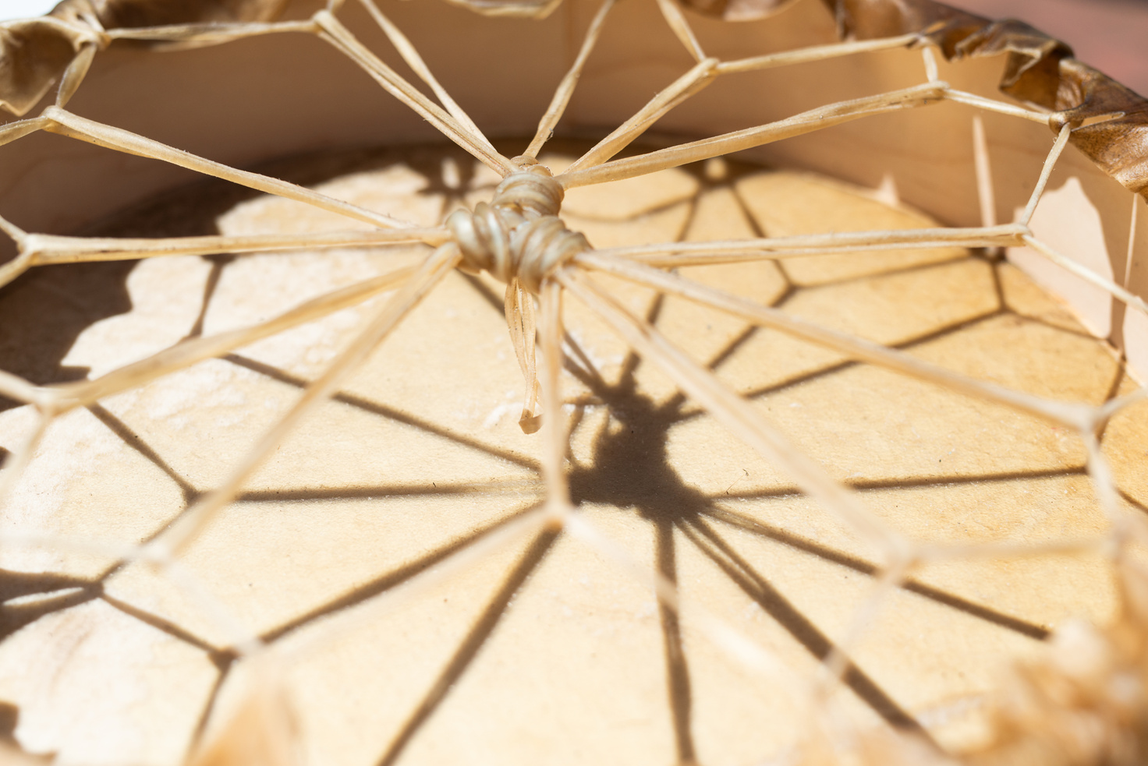
WSTPS - North Star Development
2022
2024
2025+
  Youth Delegation from Lummi visited Planet Youth in Iceland
  Centennial Accord Agreement
  Governor Inslee’s DTLL
  Trip to Iceland to witness the Model
  Kick-off gathering at Swinomish
  Tribes contract signing between Planet Youth & NPAIHB
  Governor Inslee commits $1 million of ongoing funding
  Trip to Iceland with Tribal, Federal, and State leaders
  NPAIHB, ATNI, NCAI Resolutions
  Team meetings: Tribal Leadership & Operations
  Partnering with State and Federal agencies
  Providing support to pilot Tribes as they begin implementing this System

Slide 8
WSTPS - North Star Pilot Tribes
Confederated Tribes of the Colville Reservation
Jamestown S’Klallam Tribe
Lummi Nation
Swinomish Indian Tribal Community
Tulalip Tribes

Slide 9
Contacts
Naomi Jacobson
Sarah Cook-Lalari
Quileute Tribe
Lummi Nation
WSTPS - North Star Program Manager
WSTPS - North Star Project Coordinator
njacobson@npaihb.org
sarah.cook-lalari@hca.wa.gov

