Slide 1
-OVERVIEW-
WA DEPARTMENT OF LICENSING vs. COUGAR DEN, INC. Ability to Deliver Tax-Free Fuel to Tribal Businesses
WHO WE ARE: Indian Owned and Operated Fuel Distribution Company
WHAT WE DO: Exercise Tribal Sovereignty, Increase Profit & Revenue
THE COUGAR DEN ADVANTAGE
July 18, 2017

Slide 2
-Yakama Treaty of June 9, 1855-
-Article 3-
“And provided, that, if necessary for the public convenience, roads may be run through the said reservation; and on the other hand, the right of way, with free access from the same to the nearest public highway, is secured to them; as also the right, in common with citizens of the United States, to travel upon all public highways.”

Slide 3
-TREATY RIGHT-
The Yakama Treaty of 1855 gives Cougar Den the right to travel with free access on all public highways making it a unique fuel distributor that provides a tax-free product.
Our delivered product will be free of state fuel excise tax.
Taxation on tribal territories is solely for the tribe’s exclusive use and benefit.
The WA State Supreme Court decision allows tribes to keep 100% of its taxed revenue from petroleum sales and the freedom to choose how that revenue is utilized.
Cougar Den utilizes our Elder’s words to enhance Tribal Sovereignty granted to us in our treaty in order to provide better opportunities to the generations that follow.

Slide 4
-THE SUPREME COURT RULING-
5 -4 Decision
“Really, this case just tells an old and familiar story. The state of Washington includes millions of acres that the Yakamas ceded to the United States under significant pressure. In return, the government supplied a handful of modest promises. The state is now dissatisfied with the consequences of one of those promises. ... But today and to its credit, the court holds the parties to the terms of their deal. It is the least we can do.”
- Justice Gorsuch

Slide 5
-THE RULING-
The ruling rests upon three propositions:
A state law that burdens a treaty-protected right is pre-empted by the treaty.
The treaty protects the Yakamas’ right to travel on the public highway with goods for sale.
The Washington statute at issue here taxes the Yakamas for traveling with fuel by public highway.

Slide 6
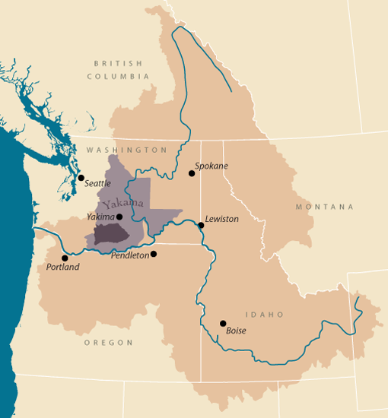
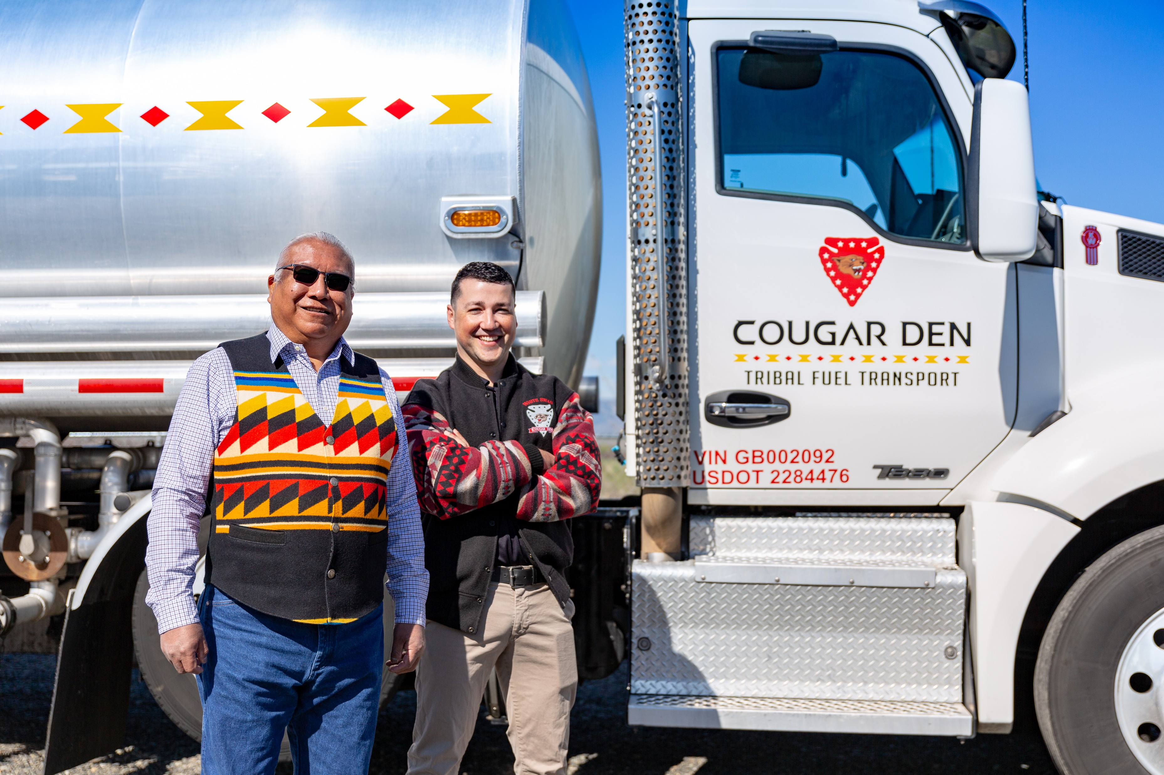
-COUGAR DEN, INC.-
We provide Indian Country with quality petroleum products, exceptional services, and unique tribal expertise that allow tribal fueling stations to meet their full potential.
Cougar Den, Inc. is a licensed Yakama Nation Business with over 40 years of knowledge and experience in tribal business. We distribute wholesale petroleum products exclusively to tribal retail outlets.

Slide 7
-COUGAR DEN, INC.-
Cougar Den is proud to be affiliated with the following organizations and programs committed to community development:

Slide 8
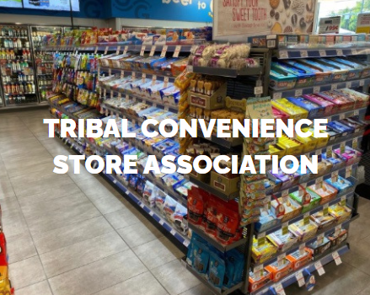
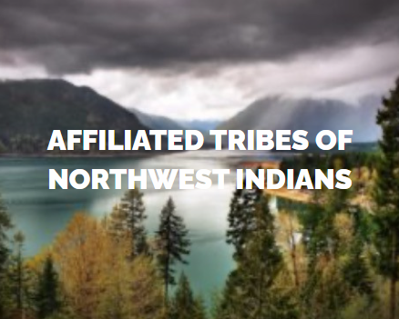
-Giving Back-

Slide 9
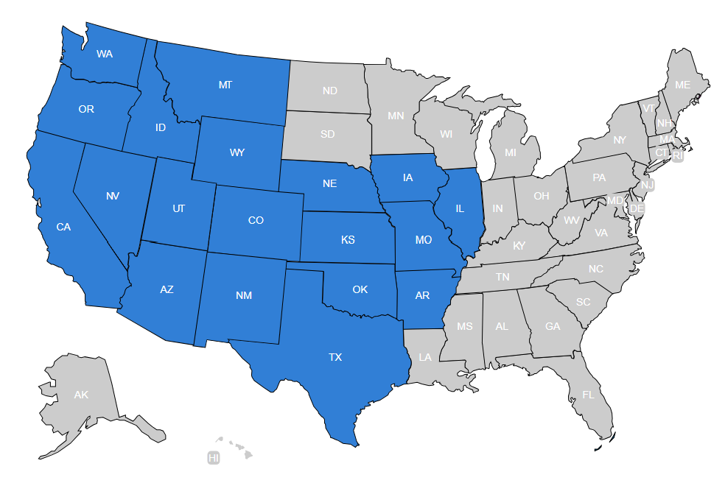
-TRUSTED DISTRIBUTOR-
State Fuel Supplier/Distributor Licenses

Slide 10
-SAMPLING OF TRIBES WE CONDUCT BUSINESS WITH-
Colville
Kickapoo
Hoopa Valley
Ft. Mojave
Citizen Potawatomi
Ely Shoshone
Blue Lake
Umpqua
Samish
Lummi

Slide 11
-INDUSTRY EXPERTISE-
Back office support with financials, reporting, inventory and labor management
On site training for class "A", "B", and "C" underground storage tank certification
Dispenser maintenance training (replacing card readers, printer motors, digital displays, hoses, and nozzles)
Consulting on POS options and programming
Customizing registers for individual needs
Vendor analysis
Food handler training
Site evaluations
C-store flow and layout (making it more profitable)
Developing "culture" (employee manuals, HR support, mission statements, training)
Ground up project consulting (new construction advice, design, equipment options)
Credit card processing and rate analysis
Fuel Man fleet card program ( allows all card types to be used)
Trade show access
Marketing - Branding or unbranding
Loyalty programs
Customized Spill prevention plan
Federal reporting requirements for Reservations (FARR, UST inspections)

Slide 12
-BUSINESS MODEL-
Pay NO State Tax for Fuel Distributed from Rack
Shop For The Best Possible Fuel Price
Provide Real Time Monitoring of Tanks
Keep Full // Market Watch // Just-In-Time
Consult And Handle Logistics Of Delivery

Slide 13
THE COUGAR DEN ADVANTAGE

Slide 14
-PRICING STRATEGIES-
Notes:
Example: .26¢ Margin w/ 10 Million Gallons > .36¢ Margin w/ 6 Million Gallons

Slide 15
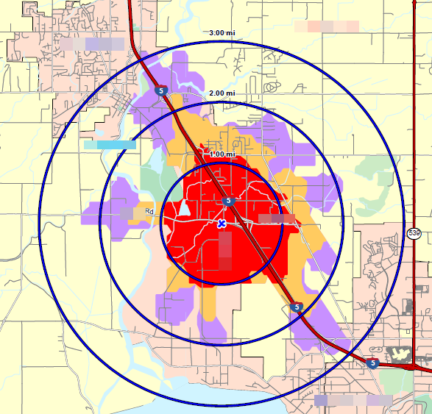
-IMPACT OF AGGRESSIVE PRICING-
Increase Volume
Increase Margins
Increase Store Traffic
Increase Inside Sales

Slide 16
-CONTACT INFORMATION-
Harris Teo, Director of Sales
509.895.3696
Fernando Lemus, General Manager
509.949.9871
Lance Pelletier, General Counsel
509-907-5111
Cougar Den Office – 509.874.2181

