Slide 1
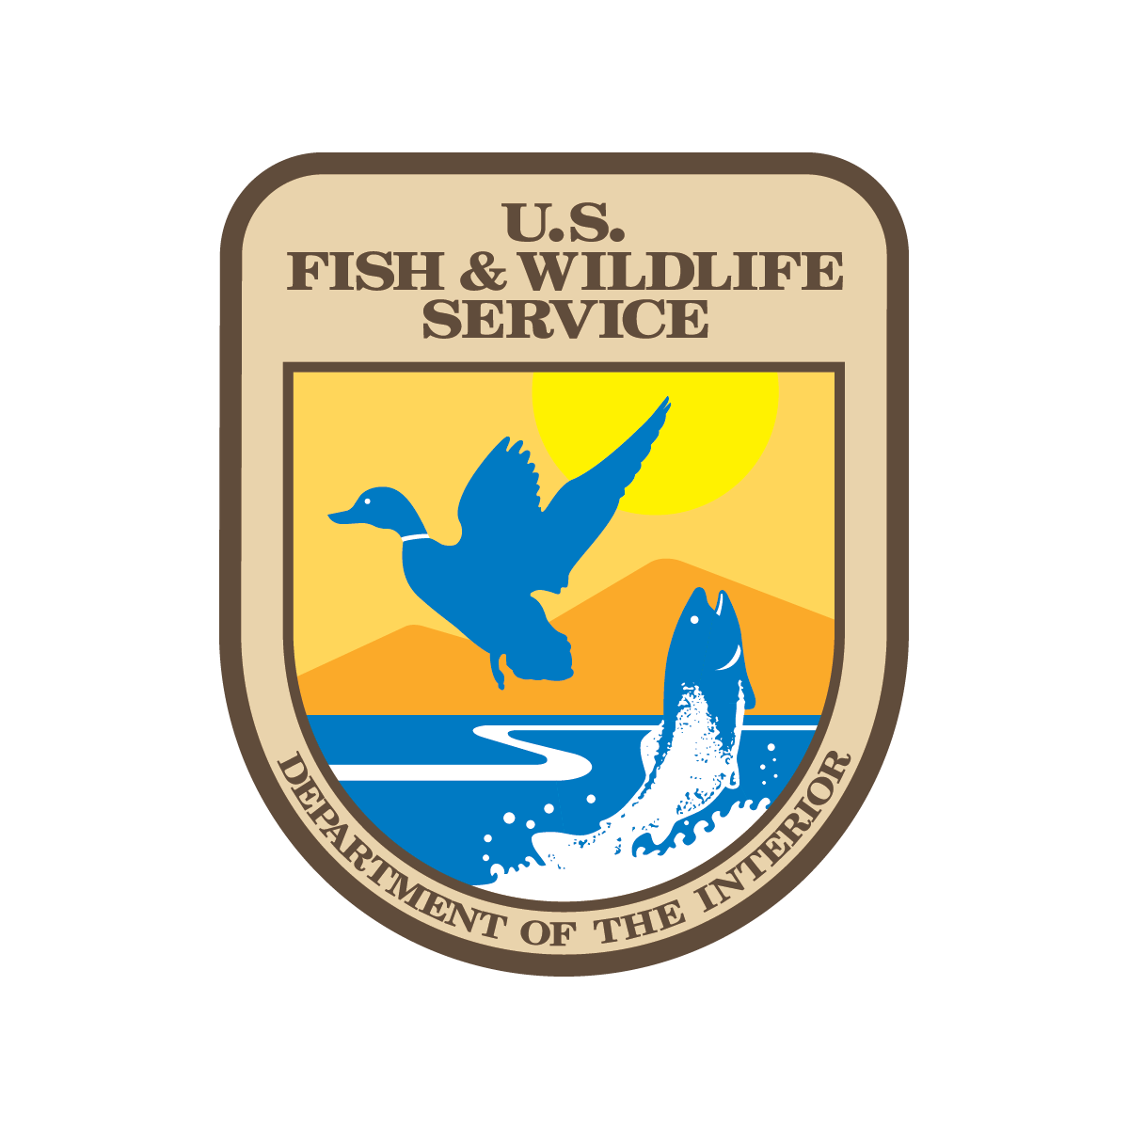
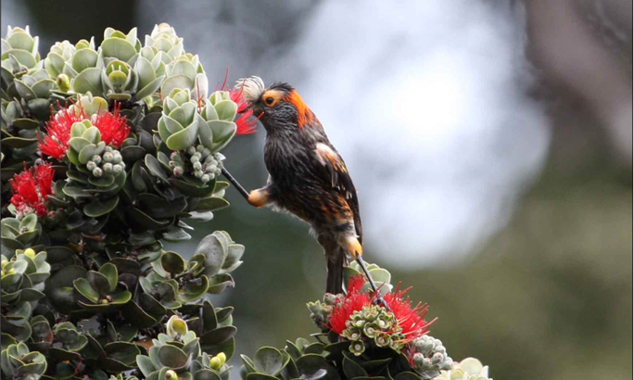
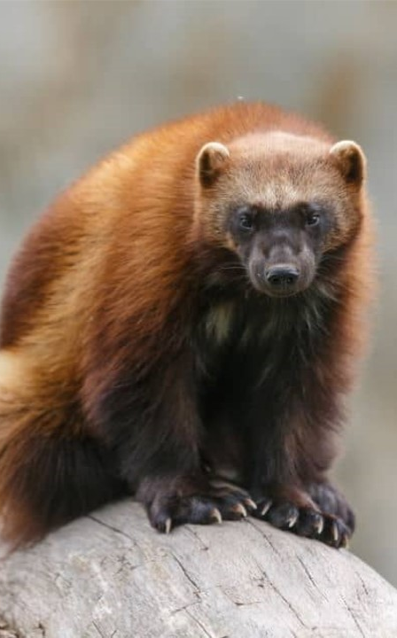
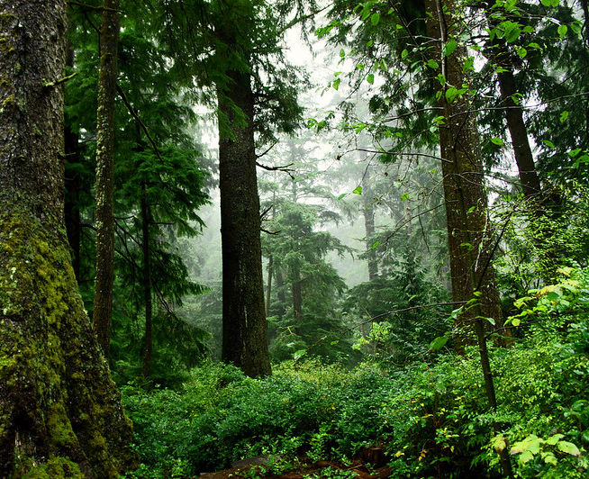
U.S. Fish and Wildlife Service
Hugh Morrison – Regional Director, Pacific Region
hugh_morrison@fws.gov
(503) 278-9526
Notes:
NCE GRIZZ
Draft EIS and 10j published September 28, 2023
Stakeholder Involvement
Related actions in Canada
Finals going through DRT and HQ review
Next steps

Slide 2
USFWS – Pacific Region
ID, OR*, WA, HI, U.S. Territories in the Pacific
46 Federally Recognized Tribes
6,200 miles from east to west
750 million acres of public lands and waters
* Excluding Klamath Basin

Slide 3
U.S. Fish and Wildlife Service
Mission
Purpose
Vision
Working with others to conserve, protect, and enhance fish, wildlife, plants, and their habitats for the continuing benefit of the American people
To protect the natural world so current and future generations can live with, live from, and find awe in lands, waters, and wildlife
We envision a future where people and nature thrive in an interconnected way and where every community feels part of and committed to the natural world around us.
Values: Integrity, Respect, Innovation, Stewardship, Collaboration

Slide 4
USFWS Pacific Region
Land (and water) manager:
73 National Wildlife Refuges, 1 WPA
5 national monuments
Species Conservation
Migratory Bird Treaty Act (620 species)
Endangered Species Act (589 listed species)
Fisheries Co-Manager
40 fisheries field stations (US v. OR, Pacific Salmon Treaty)
60 million salmonid eggs and fish distributed and released annually
Conservation Investments
Over $220 million in active conservation grants

Slide 5
Co-Management/Co-Stewardship
National Fish Hatcheries
Lower Snake River Compensation Plan
National Wildlife Refuges
Habitat Restoration
First Foods Harvest
Fire Management
Endangered Species
Migratory Bird Conservation
Treaty and Trust Responsibility guides all our work.

Slide 6
Recent Co-Stewardship Agreements
Nez Perce Tribe (June 2022) - Dworshak NFH
Jamestown S’Klallam Tribe (August 2024) - Dungeness and Protection Island NWRs
Going Forward: More Proactive Outreach

Slide 7
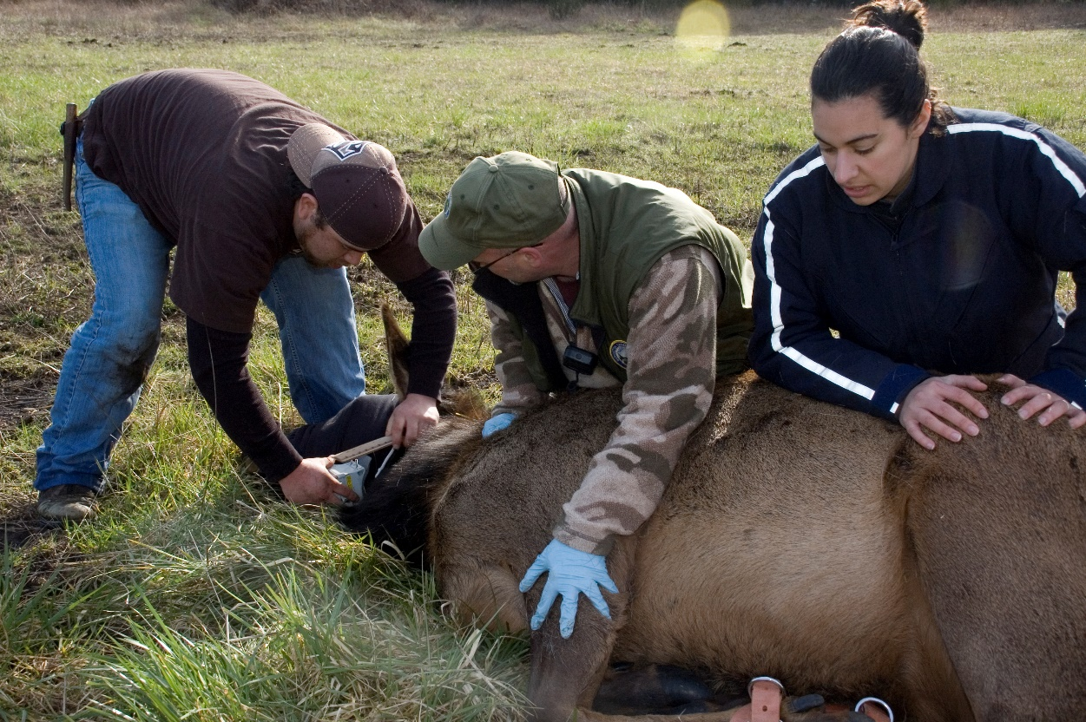
Thank You!

