Slide 1
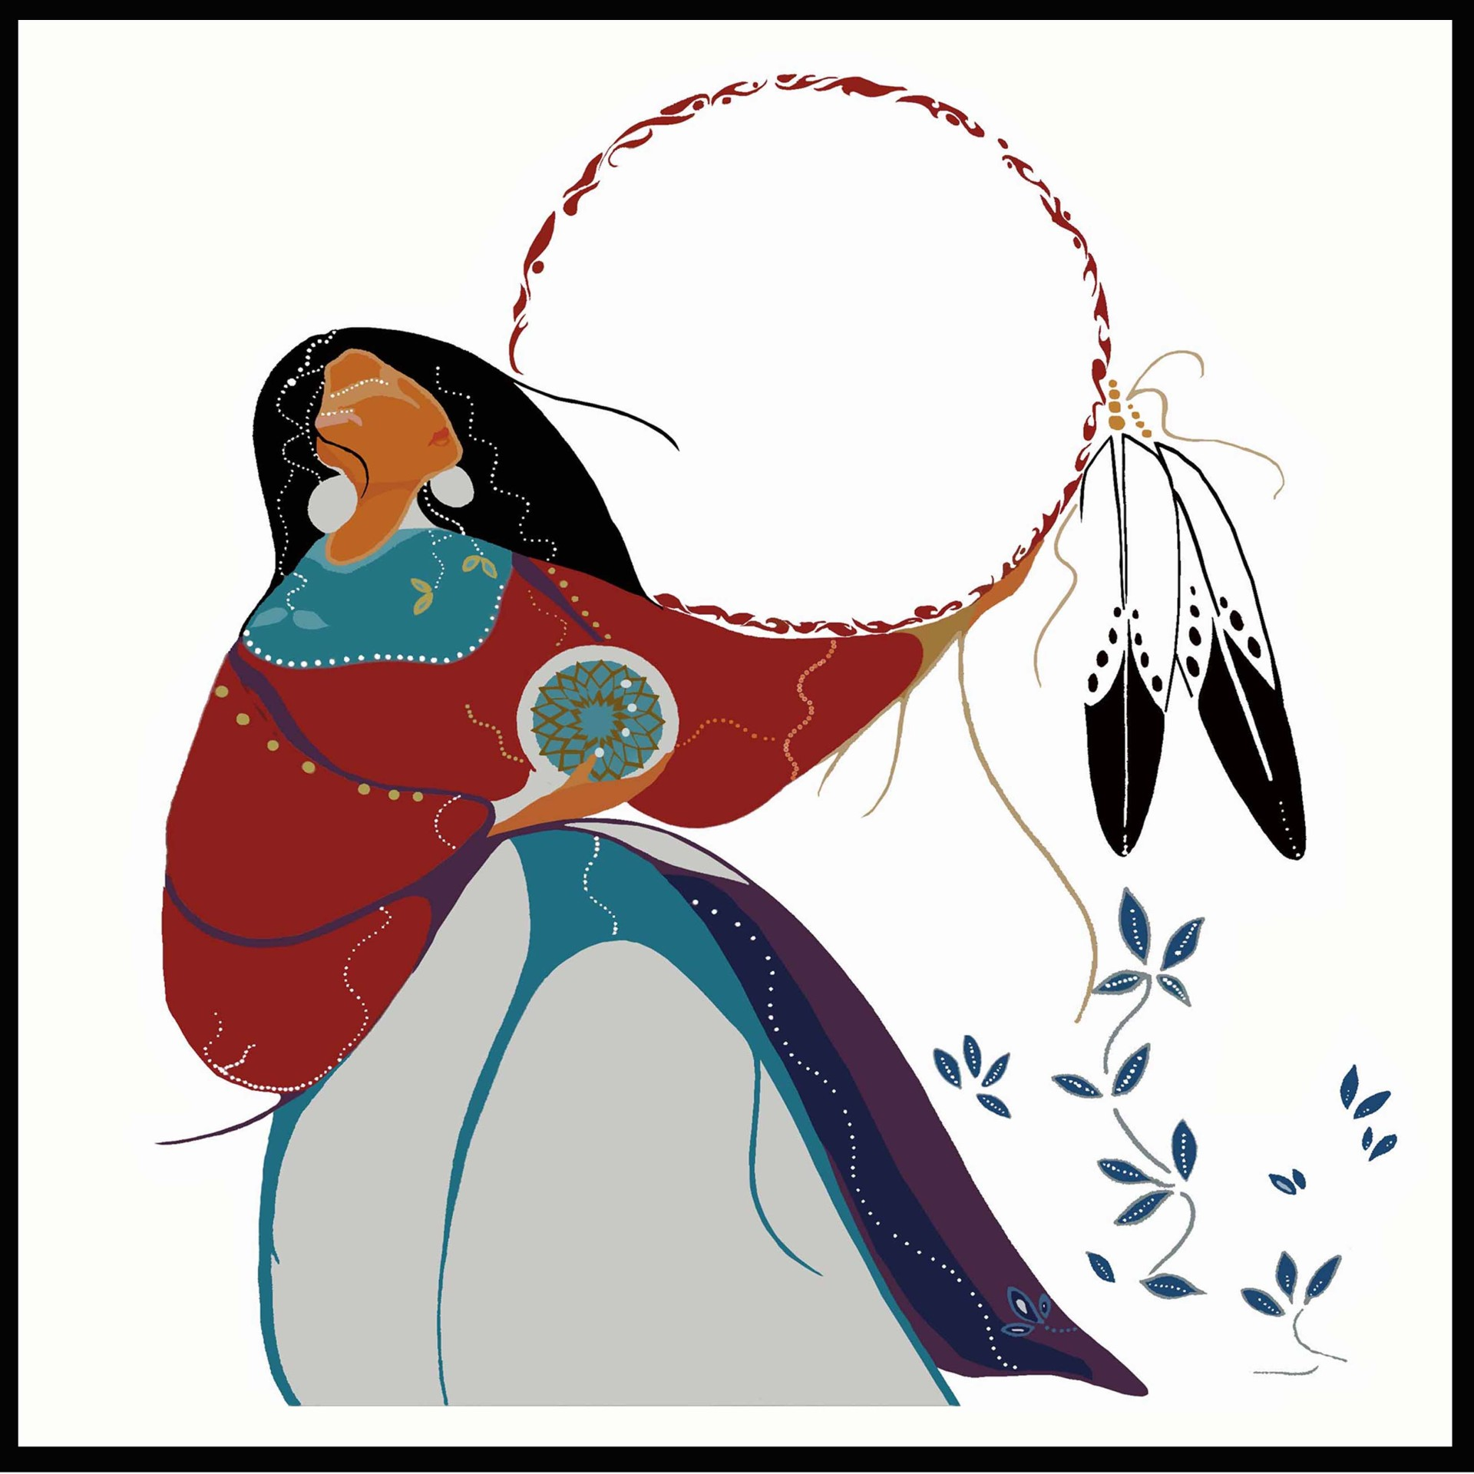
MOTHER NATION
Mother Nation is a 501(c)(3) non-profit organization that delivers social and cultural healing services for Native women and families, including single dads. Our services nurture, create stability, and inspire growth We provide cultural healing circles, homeless prevention, mentorship, MMIR Family Advocacy, workshops, and training to transform the journey of Native women and families into natural leadership and restore the cultural strength of Indigenous people.

Slide 2
Mother Nation: Inspiring Native Women and families
Our Mission is to provide culturally informed healing services and support to Native American women and families.
Established to address the unique challenges faced by Native women, rooted in cultural traditions and community values.
Core Services:
Cultural Healing: Workshops, talking circles, and traditional practices to promote spiritual and emotional well-being.
Mobile Advocacy: Support for survivors of domestic violence, sexual assault, and MMIR family searches
Education: Programs to raise awareness and prevent violence within Native communities.
Community Building: Initiatives to strengthen community ties and promote cultural resilience.
Impact: Positive outcomes in the lives of Native women and families to insprie, healing, and cultural resilience

Slide 3
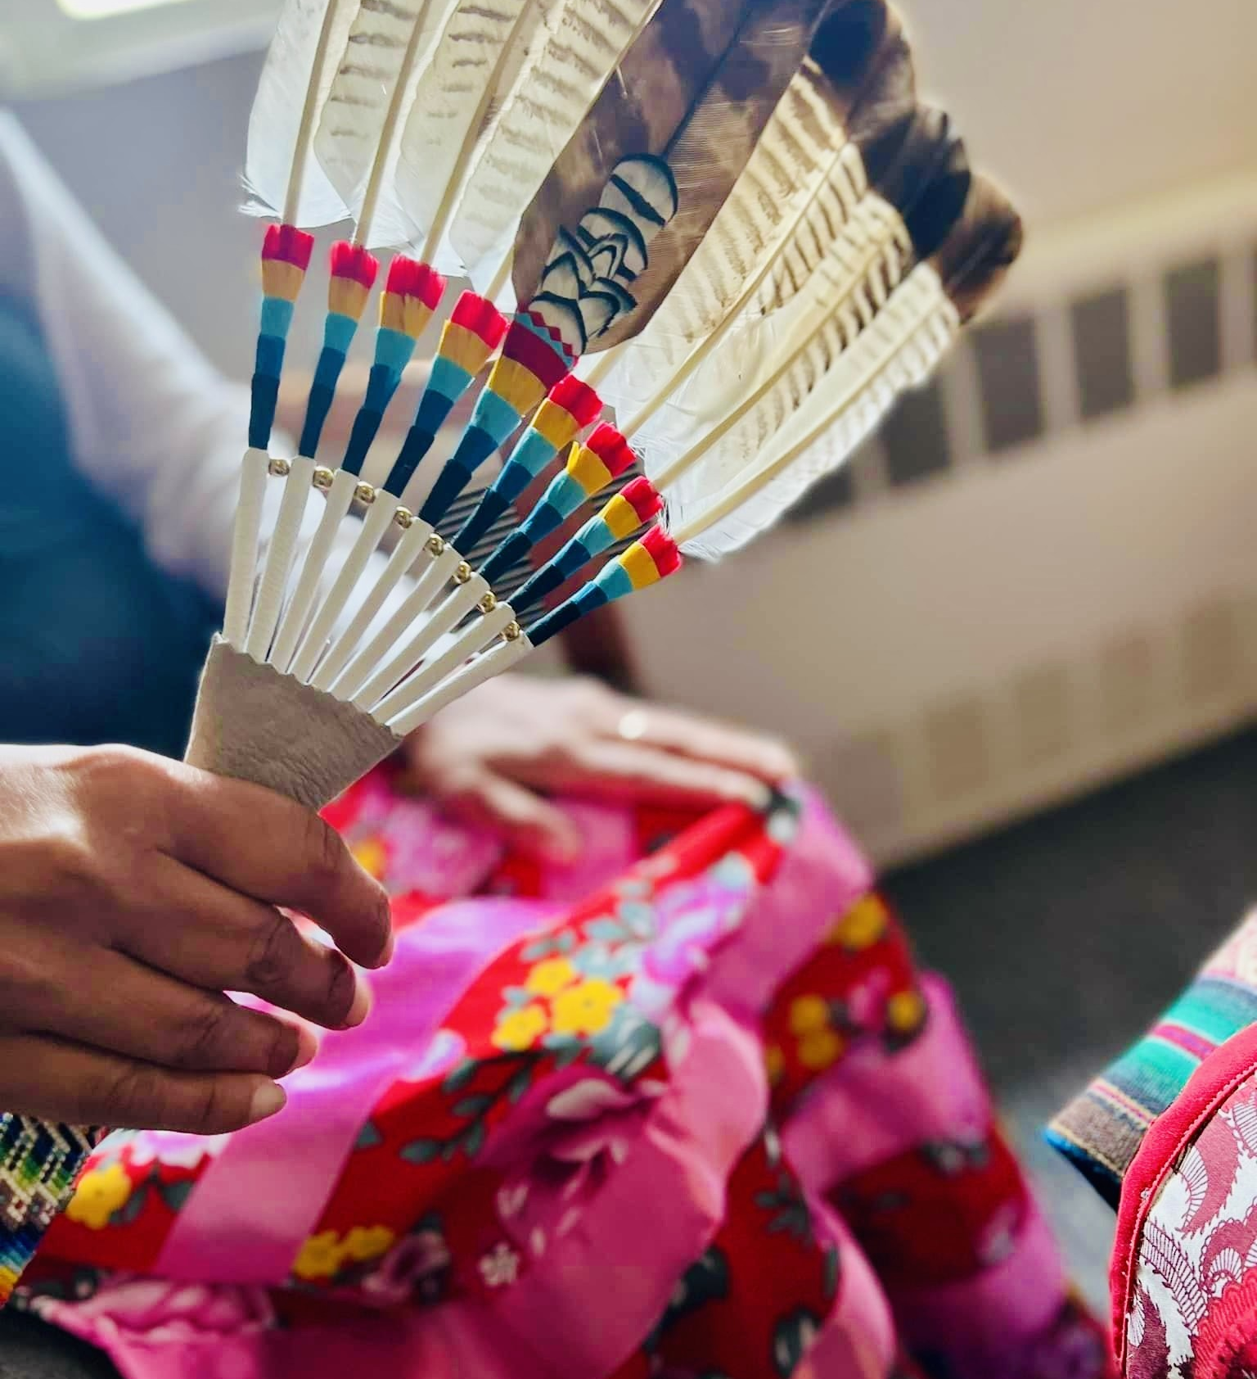
Challenges Faced by Native American Women
Disproportionate rates of substance abuse and overdose deaths
Programs range from 2 weeks to 6 months.
Most treatment and recovery programs exclude children resulting in a loss of communication between women and children
Many women face obstacles on where to start with minimal support.
After reuniting with family following treatment, several relationship barriers set in
Women in domestic violence relationships outgrow their relationships and chose not to stay with their spouse.
Only 34%of Native American women attending treatment stay on their path of sobriety. (Center of Disease Control 2010)

Slide 4
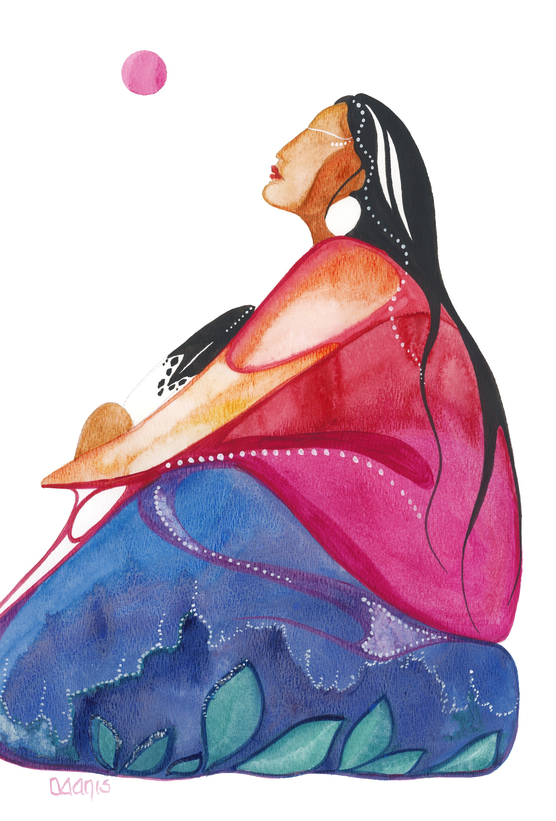
The Solution: Spirit Journey Village
Spirit Journey Village is a sanctuary providing safe, supportive transitional housing
Culturally informed healing services and comprehensive support
Focus on community and sisterhood empowerment and cultural resilience

Slide 5
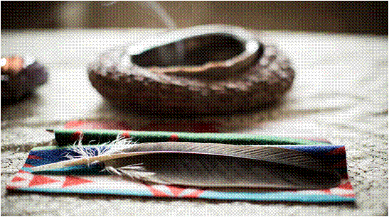
“Our cultural program is integral to the
native women in building a solid foundation to find their place in society” and contributes to our success rate of 80%!
Visit us at www.ccs.org
Click on housing, transitional.
Weekly Talking Circles
Sweatlodge onsite
Weekly recovery groups
Custom monthly cultural workshops
Cultural Outings
Weekly Traditional Healers

Slide 6
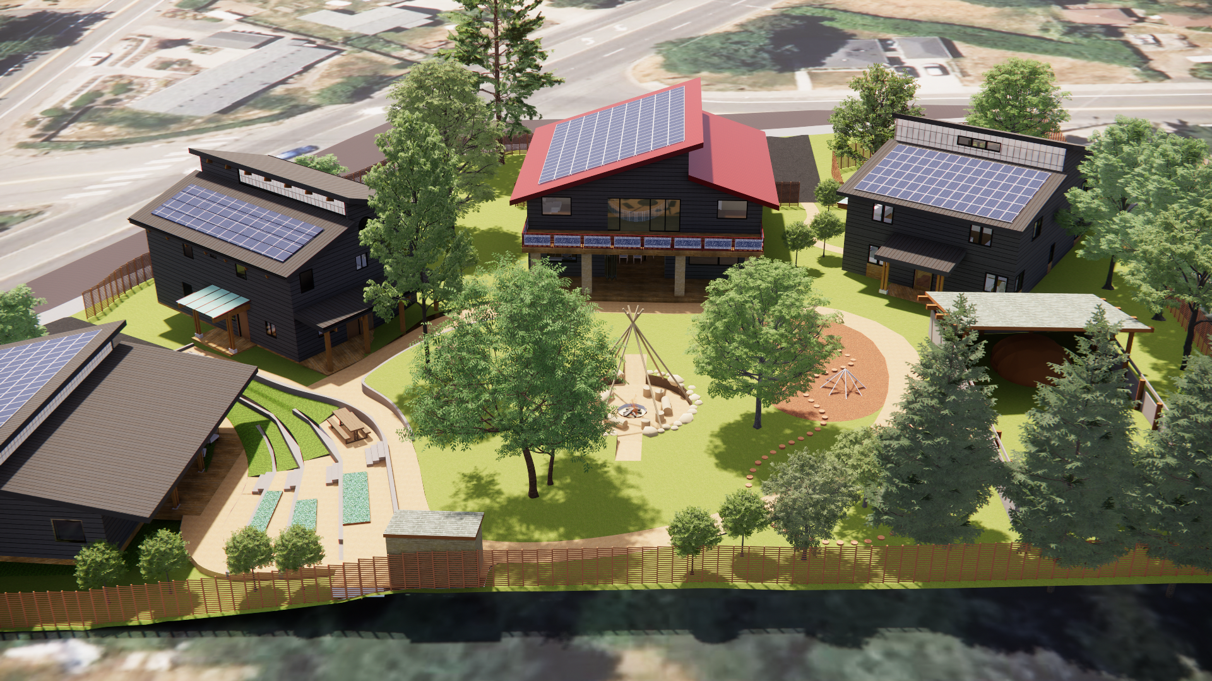
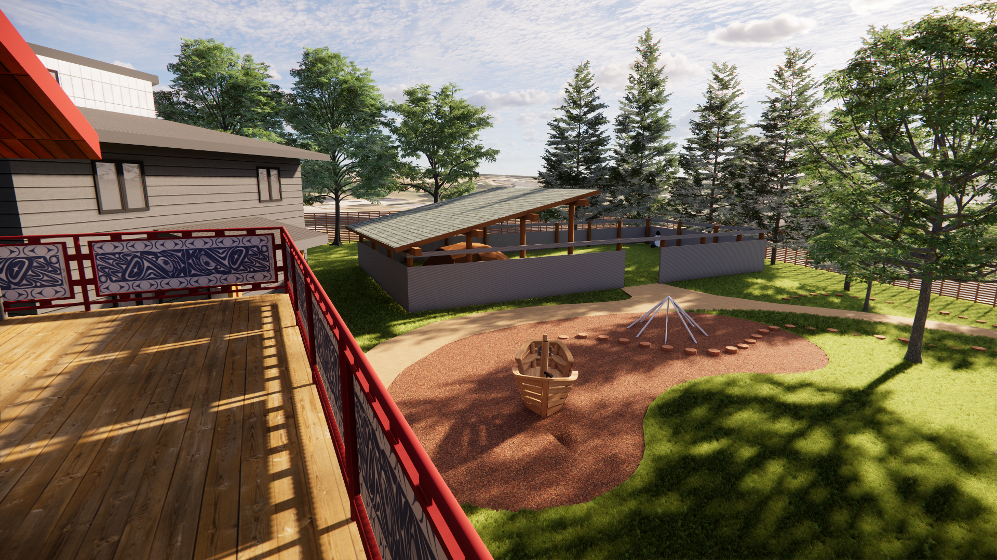
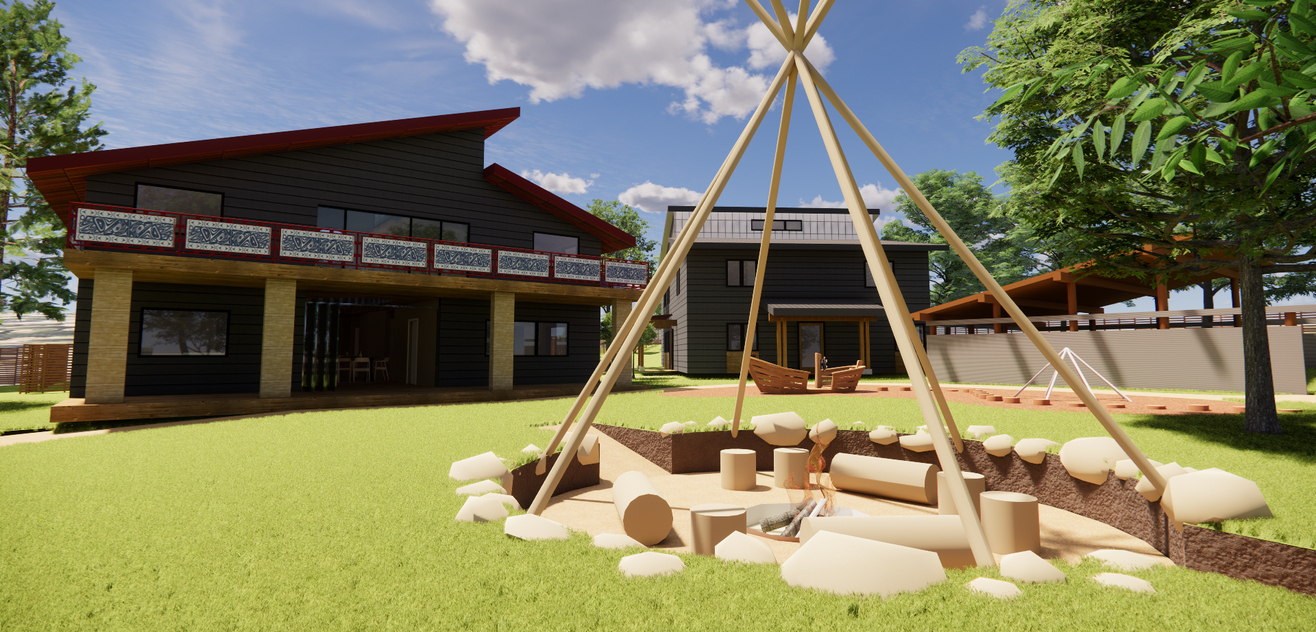
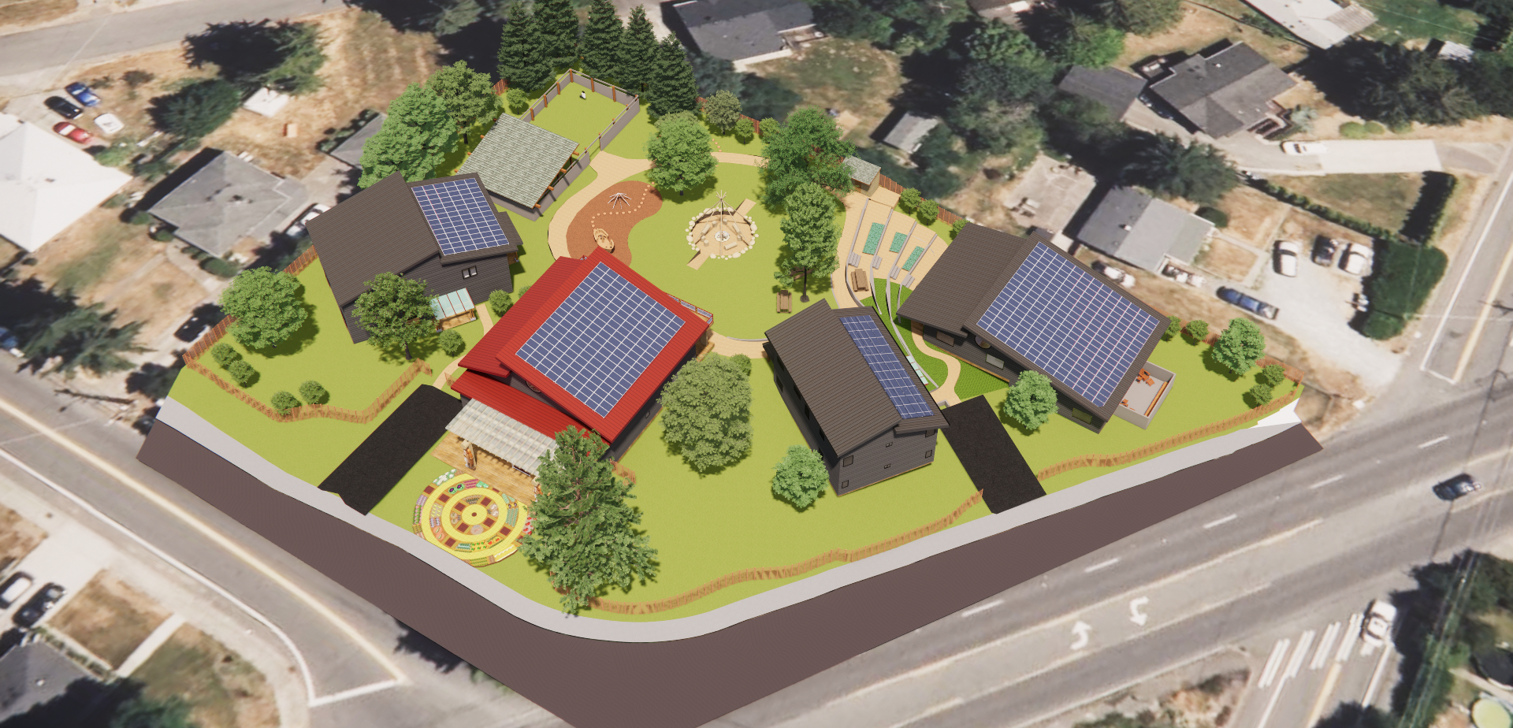

Slide 7
Spirit journey village

Slide 8
Positive Outcomes
Empowerment of women to reclaim their spirit and cultural identify
Reduction in homelessness and vulnerability among Native women
Improved physical, emotional, intellectual, and spiritual health
Prevention of Missing and Murdered Indigenous Women (MMIW). Providing safe and supportive environment reduces the risk of women becoming victims of violence and disappearance
Strengthening Tribal Communities: This project contributes to the overall well-being and resilience of Tribal communities to leave no tribal member behind. This will become a National Model.

Slide 9
How Tribes Can Help
Support the Spirt Journey Village through donations, gifts, or construction materials
Join the effort to create a nurturing and sustainable community for Native women and their families
Partnership Opportunities: By investing in this capital project and/or operational support you can have an even greater positive impact on protecting and nurturing Native women and families

Slide 10
Join Us In Making a Difference
Recap of the importance of supportive housing for survivors
Get involved and support the mission of MN and SJV

