Slide 1
ATNI Annual Convention 2024
Bureau of Ocean Energy Management
Co-Stewardship
October 2, 2024
Doug Boren| Regional Director | BOEM Pacific Region

Slide 2
BOEM Mission
To manage the development of U.S. Outer Continental Shelf (OCS) energy, mineral, and geological resources in an environmentally and economically responsible way.
BOEM manages almost 3.2 billion acres of the U.S. Outer Continental Shelf
BOEM is one of the 11 Bureaus of the U.S. Department of Interior (DOI)

Slide 3
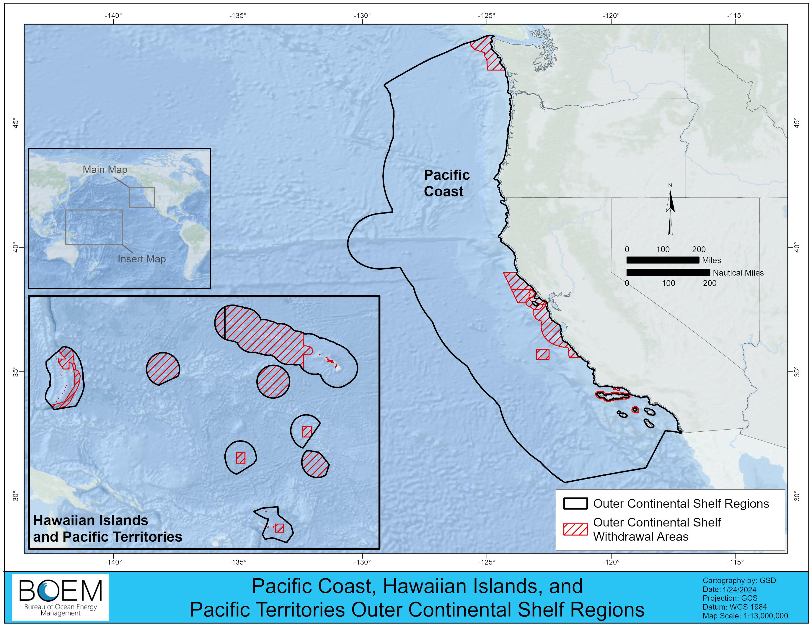
Background: BOEM Pacific Region Jurisdiction
Jurisdiction in the Pacific Region:
OCS typically extends from 3 to 200 nautical miles off the coast of California, Oregon, Washington, Hawaii, and the Pacific Territories
Excludes National Parks, National Marine Sanctuaries, National Monuments, National Wildlife Refuges

Slide 4
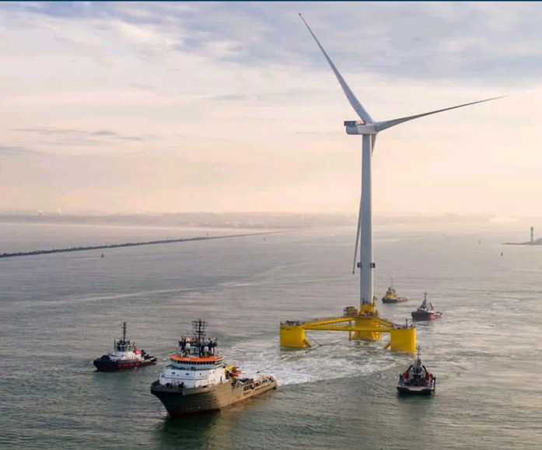
Offshore Wind Leasing and Planning in the Region
Supporting State and Territory Renewable Energy and Climate Goals
California
Five existing offshore wind leases, additional areas
needed to achieve State goals
Oregon
Lease sale delayed
Hawai'i and Guam
Active planning to find areas appropriate for leasing
California, Hawai'i, and a U.S. Territory listed in BOEM’s 5-Year Leasing Schedule for 2028

Slide 5
BOEM Co-Stewardship
Joint Secretarial Order 3403
BOEM leadership team participating in DOI Co-Stewardship training; BOEM regional staff participating in regular Tribal engagement training
Exploring opportunities to develop Co-Stewardship agreements
BOEM Environmental Reviews
Inviting early consultation and Cooperating Tribal Nation status for environmental reviews under National Environmental Policy Act
Pacific Region Environmental Studies (co-production of knowledge and integration of IK)
West Coast Tribal Cultural Landscapes (multiple Tribes participating)
Ancient Landforms off the Washington Coast (Quinault Indian Nation)
Traditional Cultural Places Nomination (Santa Ynez Band of Chumash Indians)

Slide 6
Doug Boren | douglas.boren@boem.gov

