Slide 2
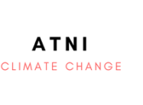
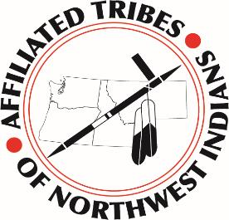
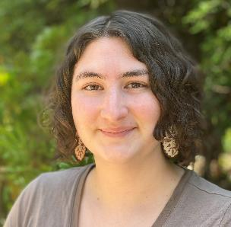
Patrick Freeland, MS
Sr. Tribal Liaison
Muscogee Nation of Oklahoma
Kylie Avery, BS
Asst. Tribal Liaison
Shawnee Tribe
PatrickFreeland@atnitribes.org
kavery@atnitribes.org

Slide 3
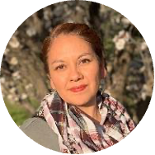
Farewell Amelia
Former Interim Sr. Tribal Liaison, ATNI Climate Change Program
Appointed to Advisory Council on Historic Preservation by President Biden
Chair of the Tribes and Indigenous Peoples Committee

Slide 4
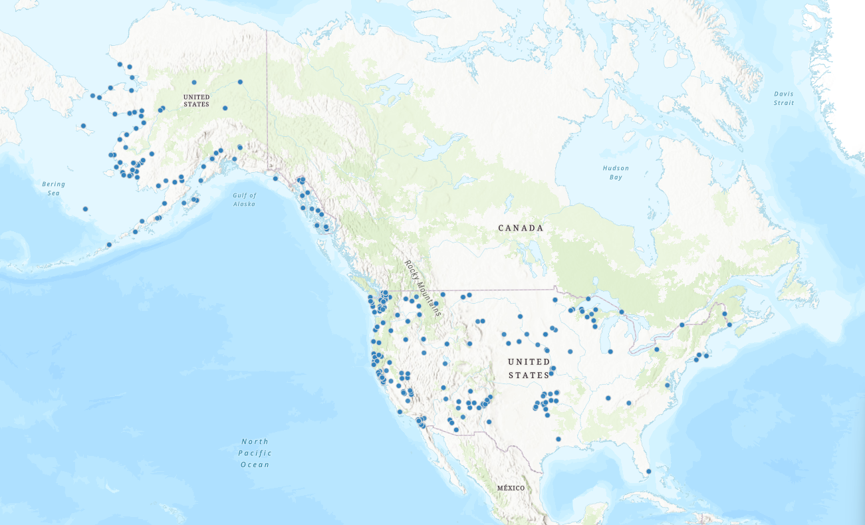
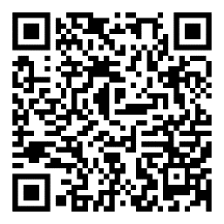
BIA Tribal Climate Resilience Program

Slide 5
BIA Tribal Climate Resilience Program
Tribal Climate Resilience Liaison Network
Tribal Climate Youth Programs
Voluntary Community-Driven Relocation Program
Tribal Climate Resilience Resource Directory
Tribal Climate Resilience Annual Awards Program
$120 million available across three funding categories: (1) Planning (2) Implementation (3) Relocation, Managed Retreat, Protect-in-Place (RMP) Staff.
Applications must be submitted online by October 18, 2024.

Slide 6
BIA Tribal Climate Resilience Network
Help Tribes access information, data, and expertise
Facilitate research integrating Indigenous Knowledges (IK); and
Support Tribal forums and information exchange.
NW Climate Adaptation Science Center (CASC)
Produce accessible and actionable science on climate change impacts and adaptation; and
Ensure access to scientific expertise, funds, & resources

Slide 7
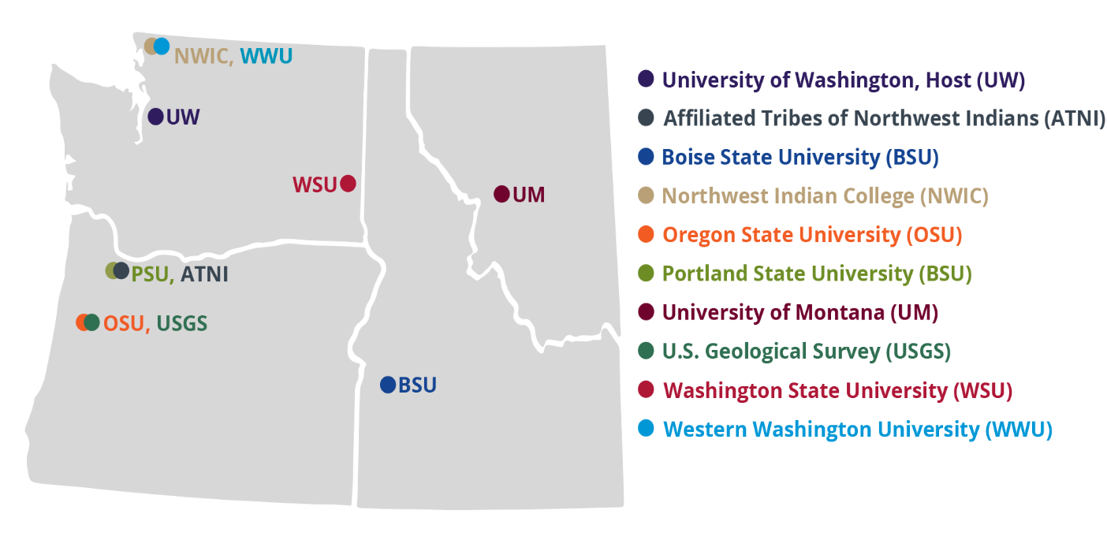
NW CASC Consortium Partners

Slide 8
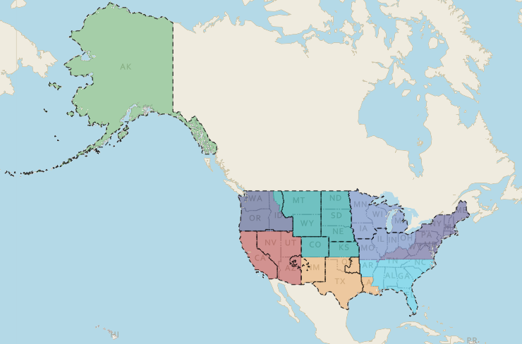
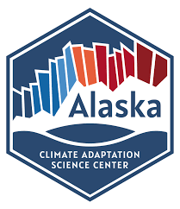
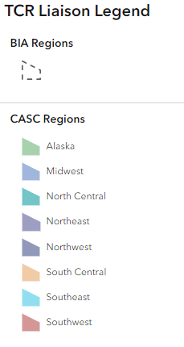
BIA / USGS-CASC Tribal Climate Resilience Liaison Network

Slide 9
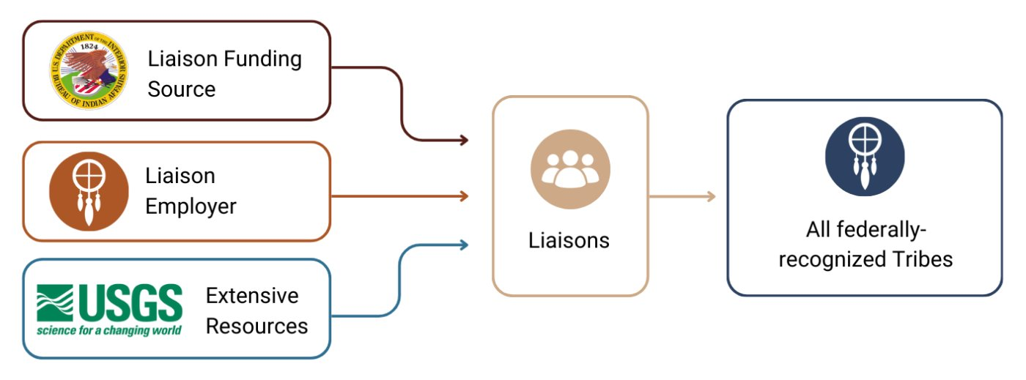
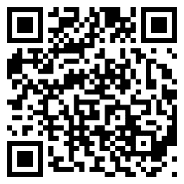
BIA Tribal Climate Resilience Liaisons

Slide 10
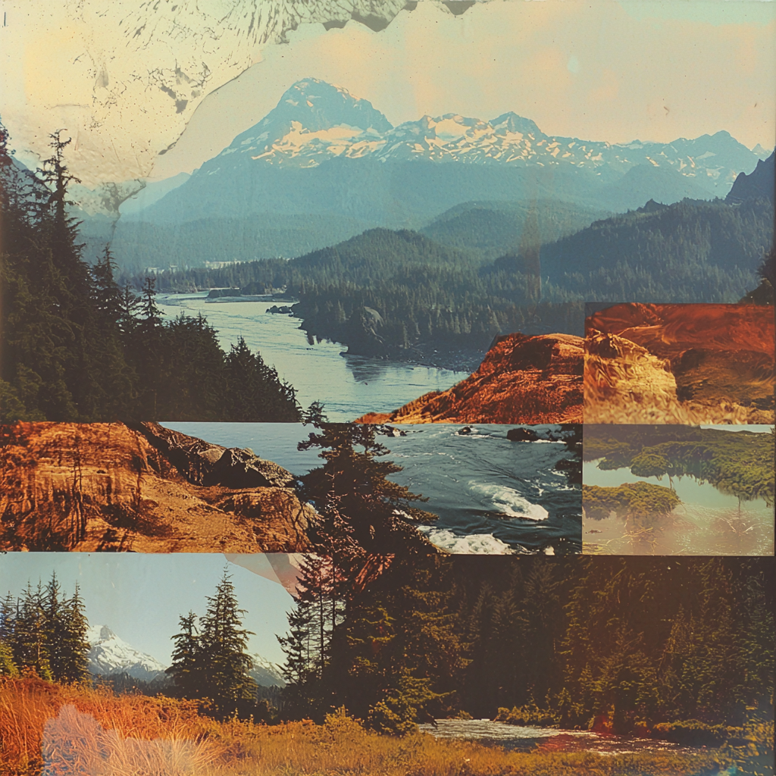
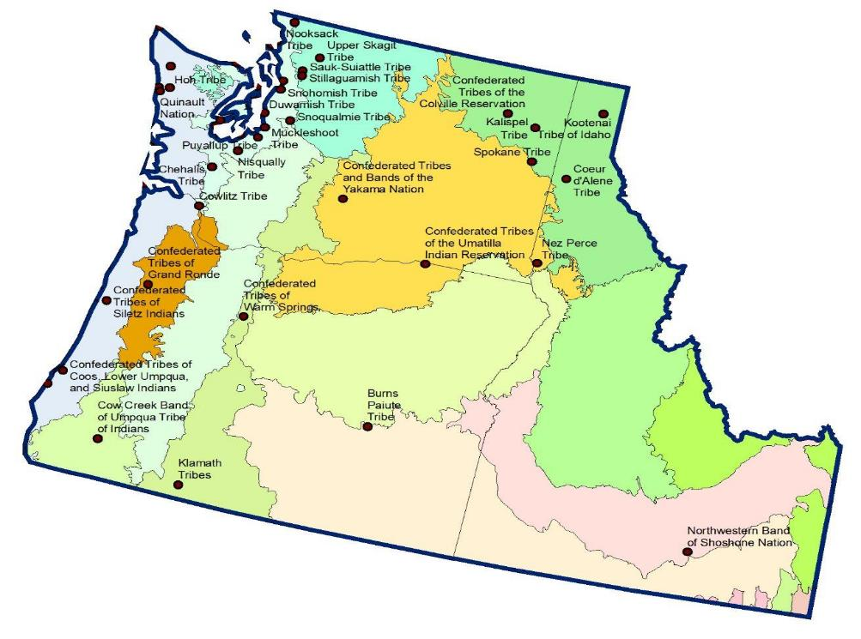
NW- CASC Tribes & Ecoregions

Slide 11
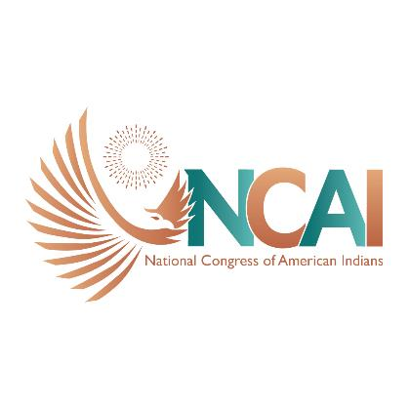
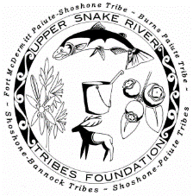
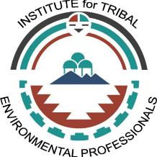
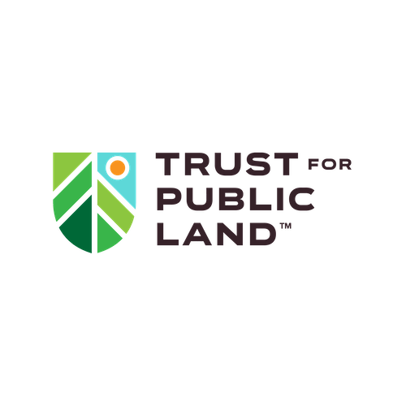
ATNI Climate Program Partners

Slide 12
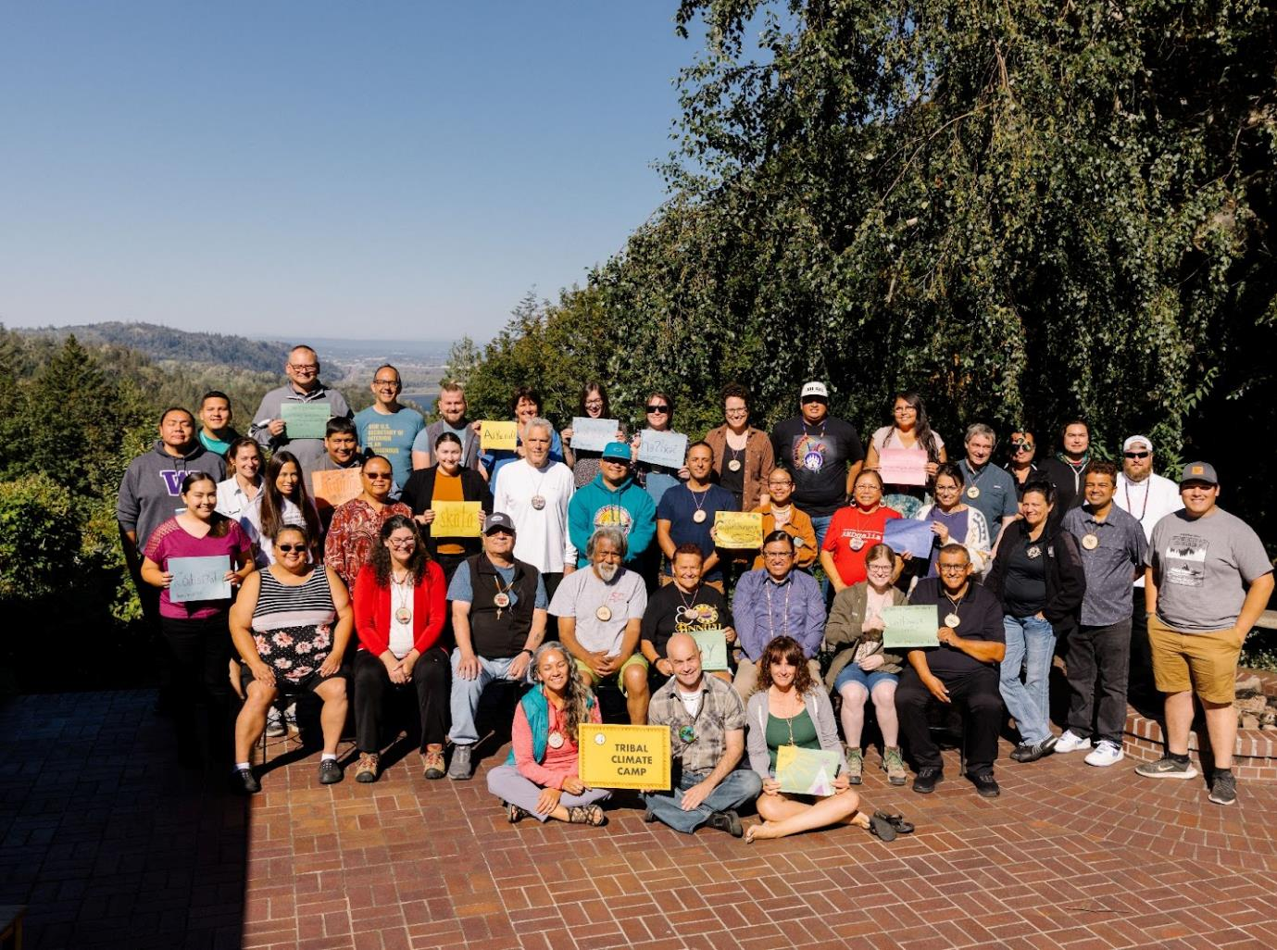
Tribal Climate Camp
August 25-30,
Corbett OR
Notes:
Tribes Represented: Hoh Indian Tribe, Jamestown S’Klallam Tribe, Port Gamble S’Klallam Tribe, Columbia River Inter-Tribal Fish Commission, Scotts Valley Band of Pomo Indians, Sauk-Suiattle Indian Tribe, Snoqualmie Indian Tribe, Confederated Tribes of Yakama Nation, Nez Perce Tribe, Confederated Tribes of Warm Springs, White Earth Band of Chippewa, Fort Peck Assiniboine & Sioux Tribes
Outcomes: Increased Ability to engage community in climate change planning, ability communicate climate impacts to Tribal community, comfort applying for climate change related funding, overall increase in knowledge on climate change planning, ability to find and use climate data and technology, increased knowledge in community engagement

Slide 13
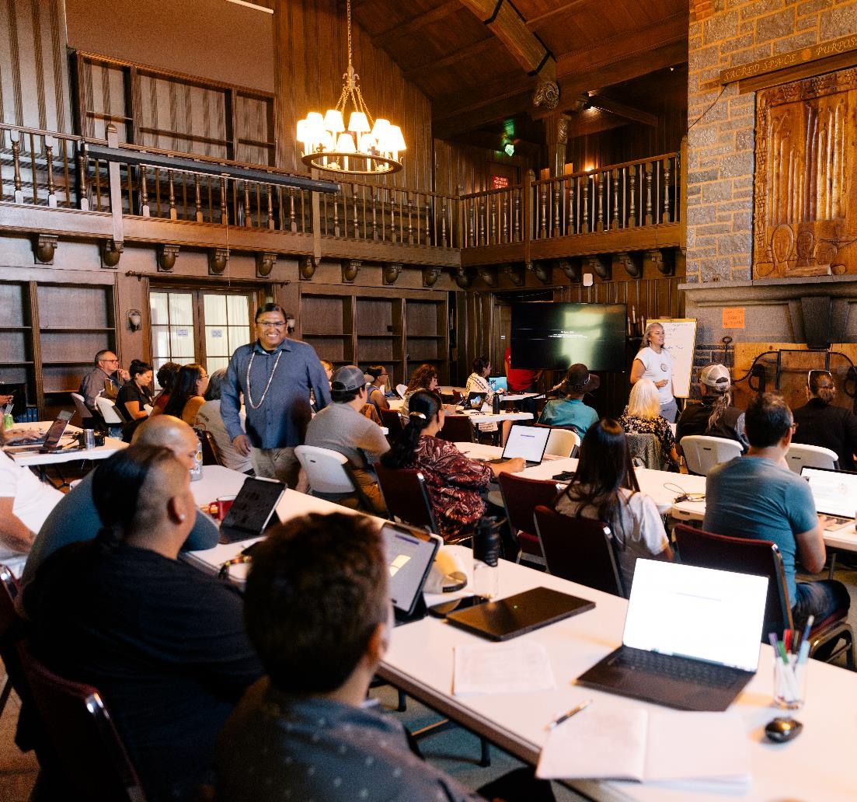
Tribal Climate Camp
Tribe / Tribal Organizations Present
Hoh Indian Tribe
Jamestown S’Klallam Tribe
Port Gamble S’Klallam Tribe
Columbia River Inter-Tribal Fish Commission
Scotts Valley Band of Pomo Indians
Sauk-Suiattle Indian Tribe
Snoqualmie Indian Tribe
Confederated Tribes of Yakama Nation
Nez Perce Tribe
Confederated Tribes of Warm Springs
White Earth Band of Chippewa
Fort Peck Assiniboine & Sioux Tribes
Notes:
32 Tribal Delegates (Tribal Leaders) (Including 7 Elected Tribal/Hereditary Leaders, Climate/ENV Managers, and Community Knowledge Holders)
During the week-long camp, each Tribal Delegation develops a plan addressing a climate task, priority, or action of their choosing. At the end of the camp, each Delegation gives a presentation that demonstrates their approach to climate impacts and shares their resilience strategies. Project topics at this year’s TCC included: healthy housing (energy efficiency), community seasonal rounds and emergency management, phenology monitoring, community outreach and engagement, disaster debris planning for extreme weather events, climate resilient forest management plan development, implementation planning for existing adaptation plan, and designating a Tribal Council Special Committee to implement climate adaptation.

Slide 14
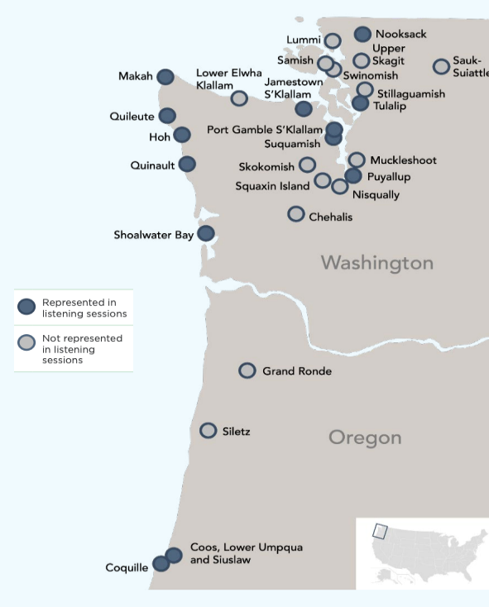
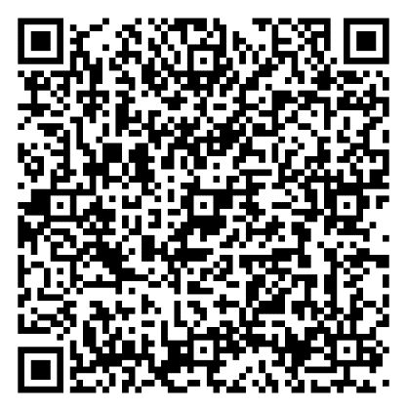
Tribal Coastal Resilience Portfolio
6 Listening Sessions
40 Participants
13 Tribes Represented
Living Addendum
tinyurl.com/4pdb2kmv

Slide 15
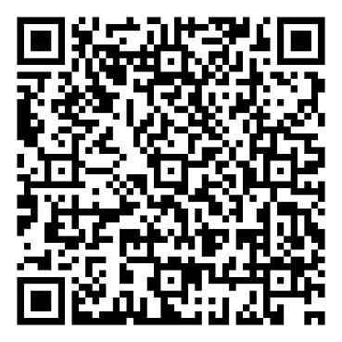
Tribal Coastal Resilience Portfolio
FUNDING
STAFF & WORKFORCE CAPACITY
PARTNERSHIPS & COLLABOARTION
TECHNICAL ASSISTANCE & CLIMATE SERVICES
COMMUNICATION, EDUCATION, & OUTREACH
Informational Webinar
October 16, 11am-12pm PT
tinyurl.com/TCRReportWebinar

Slide 16
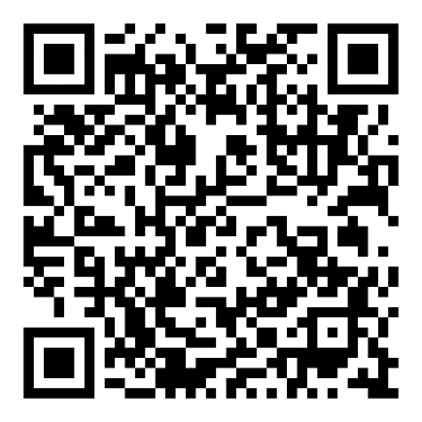
Reach Out & Sign Up for our Newsletter
Patrick Freeland, MS
Sr. Tribal Liaison
Muscogee Nation of Oklahoma
PatrickFreeland@atnitribes.org
Kylie Avery, BS
Asst. Tribal Liaison
Shawnee Tribe
tinyurl.com/ATNIClimateNews
kavery@atnitribes.org

Slide 17
BIA Tribal Climate Resilience Network
The Tribal Climate Resilience Liaison Network assembles a team of Liaisons located throughout the United States who support Tribal Nations and Alaska Native villages in their region to advance adaptation planning and implementation in the face of climate change. Liaisons serve as extension agents, facilitating research, linking Tribal needs to available resources, and coordinating trainings, workshops, forums, and exchanges. Liaisons can:
Help Tribes access information, data, and expertise with the Climate Adaptation Science Centers and elsewhere;
Facilitate research integrating Indigenous Knowledges (IK); and
Support Tribal forums and information exchange. These efforts are designed to better understand, communicate, and meet the needs of Tribes through partnerships to promote more resilient Tribal communities.
Learn more about the Tribal, federal, and university partnerships that support the Tribal Climate Resilience Liaison Network.

Slide 18
NW Climate Adaptation Science Center (CASC)
The Northwest Climate Adaptation Science Center (NW CASC) was established to help safeguard the natural and cultural resources of Idaho, Oregon, and Washington by working with partners to produce accessible and actionable science on climate change impacts and adaptation. Through multi-year cooperative agreements, CASCs operate as partnerships between the USGS and a consortium of university and non-university partners to ensure access to broad and deep scientific expertise, production of research products tailored to partner needs, and sharing of funds, resources, and facilities. The NW CASC is hosted by the University of Washington on behalf of a consortium that includes the Affiliated Tribes of Northwest Indians, Boise State University, Northwest Indian College, Oregon State University, Portland State University, University of Montana, Washington State University, and Western Washington University

