Slide 2
Energy Team Program Update
Reuben Martinez & Eli Duncan-Gilmour

Slide 3
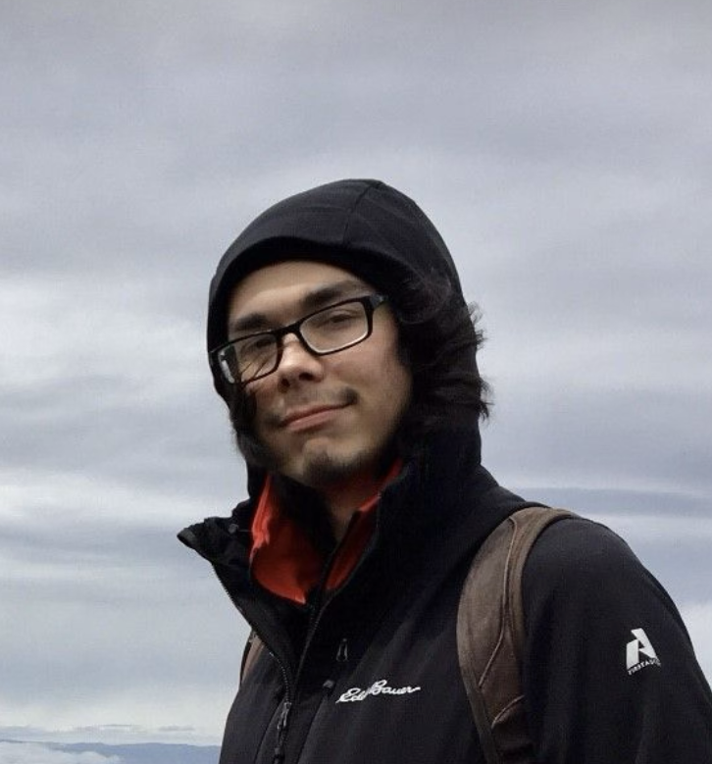
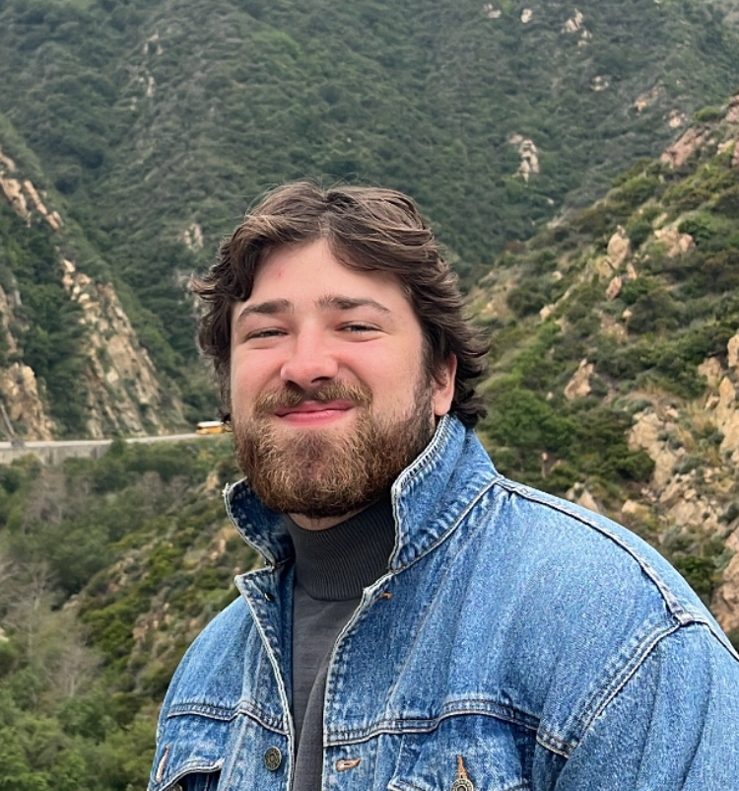
Energy Team
Reuben Martinez &
Eli Duncan-Gilmour

Slide 4
Program Updates - Winter 2025
Major engagement areas
Education Opportunities
Offshore Wind
Transmission
Siting
Energy Team Projects
Expanding Education on Energy
ATNI Gridworks Project
Created Working Group
Partnership Events
ACP Siting April 14th-16th
Notes:
Opportunities applied for
Selected for the InterTribal Opportunity Grant on 9/24
Two Energy Fellowships
Energy Connector Grant
ATNI Gridworks Project
R-step
ACP Siting April 14th-16th
Energy Working Group
Optional Policy group

Slide 5
Reuben Martinez
Energy Program Manager
Project Updates
Coalition Building
Renewable Northwest
Sustainable Northwest
ARUP
Nature Conservancy
Team Growth
Selected for the InterTribal Opportunity Grant on 9/24
Two Energy Fellowships
Energy Connector Grant
Committee Membership
POWC
PREPP
Sustainable Northwest
Email: Reuben@atnitribes.org 1 503-922-3407 ext. 408
Notes:
Ongoing Projects
- Expanding Education on Energy
- Created Working Group
- Staff Growth
Selected for the InterTribal Opportunity Grant on 9/24
Two Energy Fellowships
Energy Connector Grant
Major engagement areas
Education Opportunities
Offshore Wind
Transmission
Siting

Slide 6
Eli Duncan-Gilmour
Energy Liaison/ DOE Fellow
Ongoing Projects
- Monitoring Energy landscape
- Building partnerships and sharing information
- Creating tools to advance Tribal energy sovereignty
Major engagement areas
- Energy grid development and siting
- Tool Creation and information sharing
- network-building
Contact me: eli@atnitribes.org, cell: 845-663-6221

Slide 7
Energy Program Resources
Energy Newsletter:
tinyurl.com/ATNI-Energy-Newsletter
Energy Working Group:
tinyurl.com/ATNI-EWG
Comprehensive Climate Planning:
Email- CPRG@atnitribes.org

Slide 8
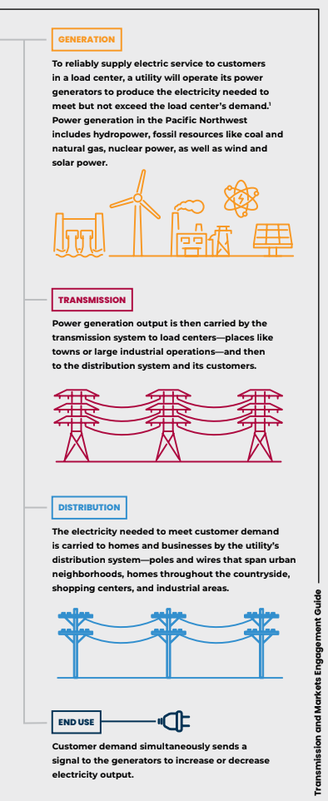
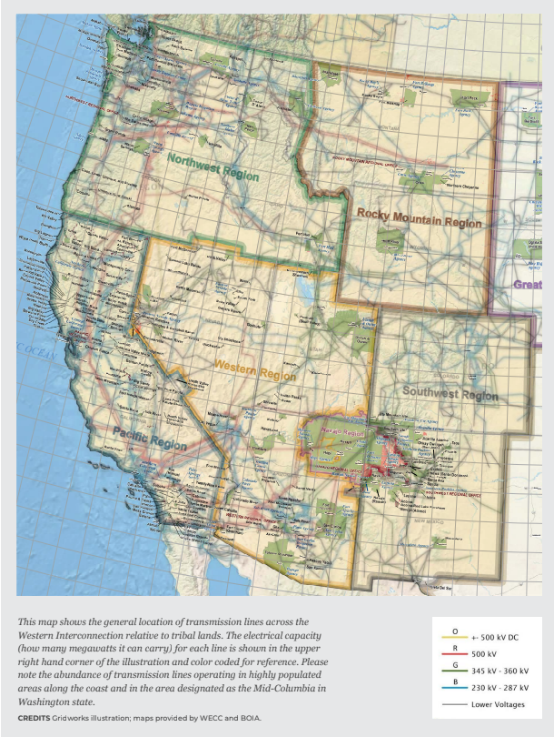
Coming Soon: ATNI Tribal Transmission Engagement Guide
Interest Form: tinyurl.com/ATNI-TEG
(Fill out the form to receive a copy upon publication.)

Slide 9
Contact Information
Reuben Martinez - Energy Program Manager
Phone Number: 1 503-922-3407 ext. 408
Email: Reuben@atnitribes.org
Eli Duncan-Gilmour - Energy Liaison
Phone Number: 845-663-6221
Email: Eli@atnitribes.org

