Slide 1
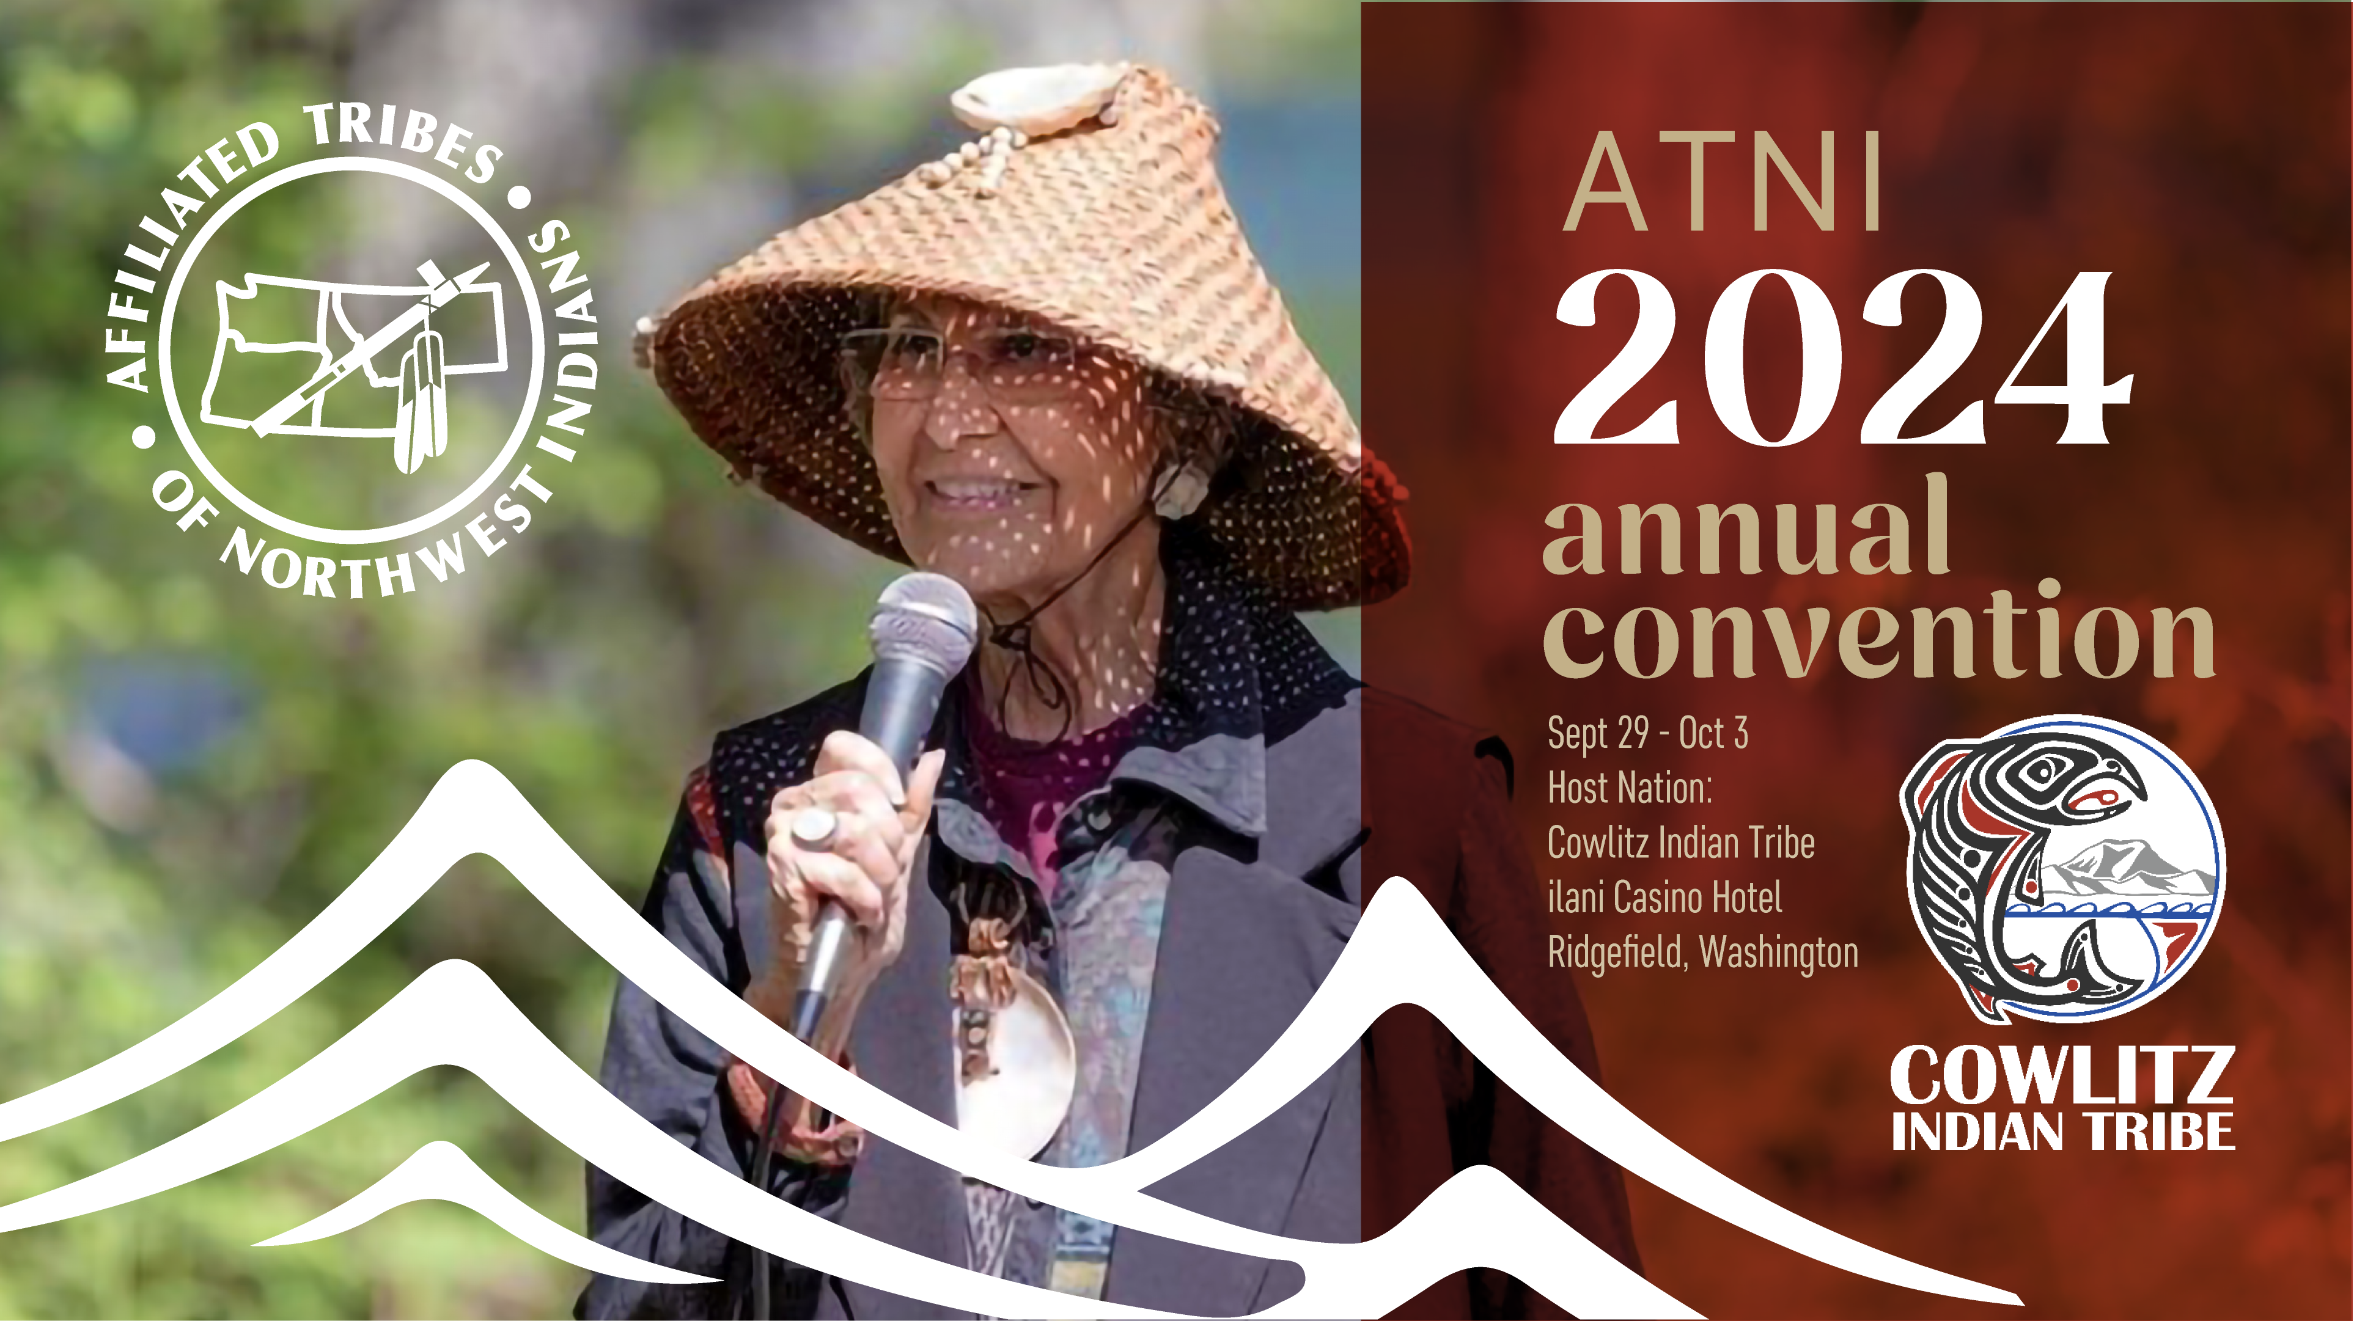


Slide 2

Tribal Water Program
2024 Changing Currents: Tribal Water Summit
& Programming
Presented by Direlle Calica, J.D.
Water is at the heart of our cultures, spirituality and society. Water sustains us and gives us life.
But water needs our help.

Slide 3
ATNI Tribal Water Program
Changing Currents: Tribal Water Summit
Water Policy – ATNI Tribal Water Vision Resolution
Water Education
Water Outreach & Engagement
About Changing Currents & ATNI Water Program

Slide 4
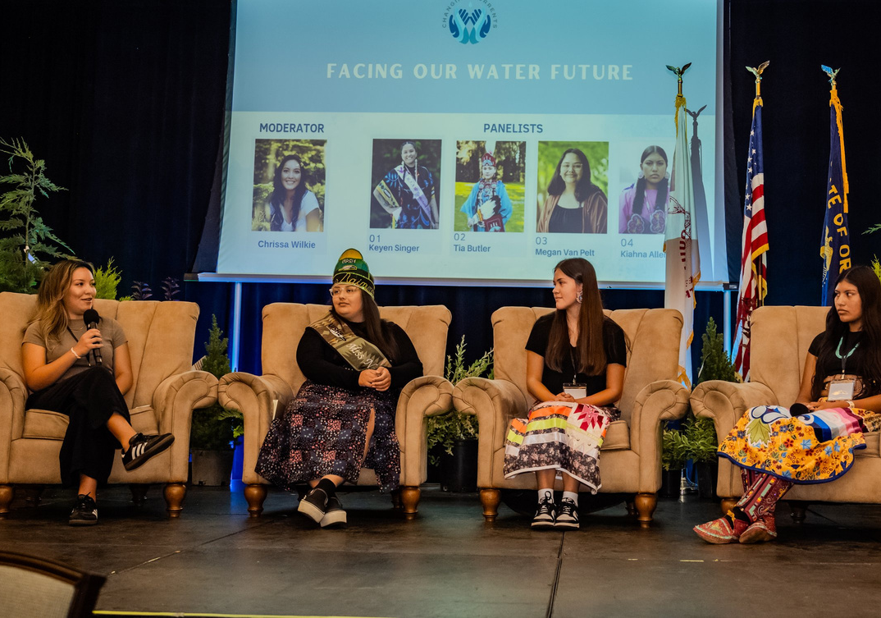
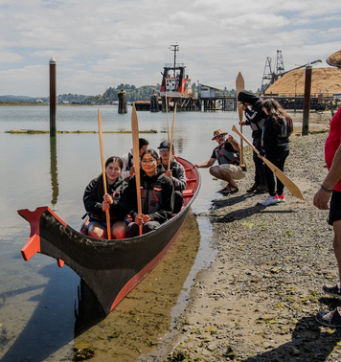
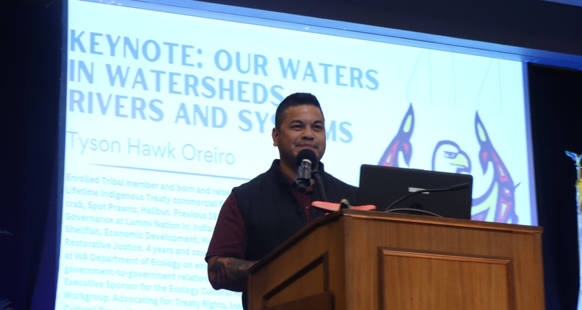
2024 Changing Currents:
Tribal Water Summit
Setting an Agenda for water — Summit to Sea
Intergenerational leadership for water
Policy – supporting an inclusive agenda for water
Network to help shape the future of our water
Interdisciplinary approach to working on water
Above: Youth & Alumni Panel—Chrissa Wilkie (Turtle Mtn/Klamath), Megan Van Pelt (CTUIR), Tia Butler (CTSI), and Kiahna Allen (CTWS)
Left: Youth Participants in host tribes canoes
Right: Keynote—Tyson Hawk Oreiro (Lummi)

Slide 5
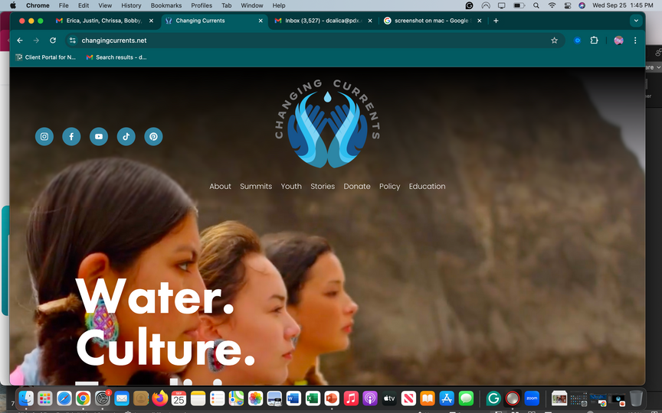

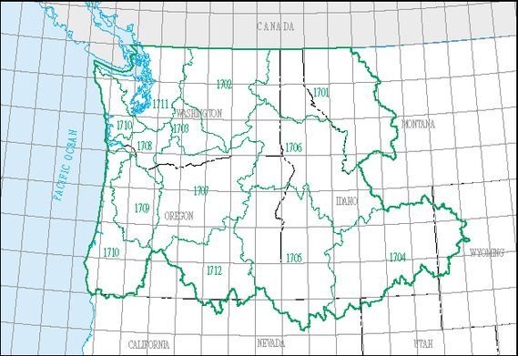
Water Education
Water Education
  Relaunch of the website
    Policy tab
    Education tab
    Top 5 Things to Know About Water
    Youth produced videos
    Lesson Plans (Grades 9-12)
  Student engagement
    United National Indian Tribal Youth (UNITY)
    Youth Summit
    Top 5 Things to Know About Water (Grades K-12)
  Virtual Story map
    Student developed and created in ArcGIS
    Tribal Water Restoration stories (linked on map)
    Youth videos (linked on map)
    Additional partnerships

Slide 6
Coordination & Resources
Gathering resources to help our water
  Support from Oregon Legislature (HECC, UO & PSU)
  Oregon Water Resources funding for Tribes $750k
Growing the tribal water team
  Through participation, work experience, career development, and job opportunities in water
Next year’s tribal water summit
  RFP for the next Summit is coming soon
  Getting our students connected to learning
  Collaborating with partners to bring more water knowledge to our tribes and communities

Slide 7
ATNI Vision for Tribal Water Resources
A product that began in 2017 and has come to fruition at the 2024 Changing Currents: Tribal Water Summit
Framework resolution that outlines key principles NW tribes have shared about water and consolidates key language about water from previous ATNI resolutions
Living and working documents that will support future regional tribal water planning
Presented for ATNI consideration in the Natural Resources Committee

Slide 8

Gratitude - ATNI Tribal Water
Learn more and help shape the future of our water.
Contact:
Direlle Calica, J.D.
dcalica@atnitribes.org
www.changingcurrents.net
Linked to the ATNI website

