Slide 1
ATNI Executive Director Report
Amber Schulz-Oliver
October 2, 2024
Notes:
So wonderful to be here in this beautiful facility.
The Cowlitz Tribe & ilani team have been incredibly generous and such a pleasure to work with
Culture night!
Thank you for hosting us in your homelands.

Slide 2
Strengthen Internal Operations
2024 Budget
HR Manual
Convention Agendas Posted Earlier
ATNI Embassy A/E Design
Coming Up:
Strengthening the Resolution Process
Streamlining Committee Structure
Creating Committee Chair Manual
Importance of ATNI Resolutions
Program-Specific Strategic Planning
Notes:
Team has been working hard behind the scenes to strengthen internal operations. Don’t see this work directly, but hopefully you’ll see smoother and more efficient programs and events.
- Been cleaning up our financials. As Sharon reported in her financial report, we are nearly caught up with our audits, and we have a new budget template. It took us a more time than expected to get on top of our funding sources, which is why our 2024 budget was so late. But we have a template and a process that will expedite the budget process.
We’re also nearly done with an updated HR Manual. That is a key tool to recruiting and retaining strong talent.

Slide 3
We’re Hiring (soon)!
Program Support
Communications
Events
Policy Analyst
Notes:
In Budget: several positions.
Each program: Program Manager and program coordinator.
Also Communications and Events folks.
And a Policy Analyst. We need someone in-house. We probably need several somebody’s in-house, but we will start with one. This position comes directly from the information we learned from you in January under the ‘Future of ATNI’ Survey.
Keep an eye out. We will post to LinkedIn, Facebook, our mailing list, and other job boards.

Slide 4
Other Initiatives
Survey of Native Nations
With Center for Indian Country Development
NorthStar Youth Prevention Model
Native Languages Strategy
Federal Administration Transition Plan
Notes:
CICD Survey of Native Nations
- the importance of a regional data set (LOOK AT LETTERS)
Currently, we have 14 ATNI Tribes that intend to take the survey, and another 25 that are considering participation. We do have commitment from Tribes in every State in ATNI and both sides of the Cascades in Washington. The CICD has been incredibly thoughtful in how they designed this survey, ensuring that the data is protected, and Tribes can answer as much or as little as they are comfortable with. ATNI will only see aggregated anonymized data, but Tribes will have full access to their own data. It’s important for us to be in control of our data story. With strong data, ATNI is better positioned to advocate on behalf of Northwest Tribes. Data can be used to communicate the needs of tribes and identify funding gaps to lawmakers. It will also show the economic power that Tribes have in our communities.
Planet Youth Iceland Prevention Model site visit to learn about the Model and observe the benefits of the Model to the Icelandic community; to speak with Icelandic leadership on the efforts behind launching systemic change in real time; and to participate in discussions and strategize on the policy changes needed to successfully implement the Model known as the Northstar Washington State Tribal Prevention System (Northstar), the name chosen by the five Washington Tribes. 5 Washington Tribes are committing to the Northstar project. Lummi, Colville, Jamestown S’Klallam, Swinomish, and Tulalip..
Native Languages: This week you heard a phenomenal panel centered on Native Language preservation and revitalization, and the role of the Federal Government to financially support all Native Language programs. We developed a survey to gather data points to inform a strategy going forward. I’ll send it out to our delgates and culture, language, and elders programs. We’re seeking responses by October 15.
Also this week, we heard from Tribal Leaders on priorities that should be included in a Federal Administration Transition plan. If you have other points to be included, please reach out to me. I have contact information on the final slide of this presentation. Which, by the way, you will be able to download from our conference app! (along with the other presentations)

Slide 5
ATNI Strategic Framework
Strategic Pillars
Robust Engagement and Collaboration
Targeted and Strategic Communications
Proactive Policy Leadership
Strengthen ATNI Capacity
Notes:
The board is Still word smithing some portions. Once complete, will send out.
Here’s a preview
Will be shared with our member tribes and committee chairs;
Seeking feedback;
Hoping to ask for it to be accepted at Winter Convention in 2025
Once accepted by the ATNI Executive Board, this draft will be shared with the ATNI Executive Committee and ATNI Committee Chairs in early September 2024. The Executive Director will present the draft before the General Assembly at the ATNI 2024 Annual Convention (September 29 – October 3). Comments on the draft plan will be accepted through December 31, 2024.

Slide 6
Actions between Conventions
Signed on to joint letter to Support for the President’s FY25 Proposal for Mandatory CSC and 105(l) Funding
Letter to Committee on Appropriations to Support for the Reclassification of CSC and 105(l) Tribal Lease Payments to Mandatory Appropriations
Letter to Senator Lisa Murkowski to support the inclusion of the “Parity for Tribal Law Enforcement Act” (S.2695) on the agenda for the Committee on Natural Resources business meeting
Notes:
Copies will be added to the Convention Final Report.
CSC = Contract Support Costs
We also provided testimony before the Senate [[]] committee (Tulalip)

Slide 7
MORE Actions Between Conventions
Sent Letter to Governor Inslee to endorse Brian Gunn to be appointed to the Board of Regents of Washington State University
Sign on to the Tribal Amicus Brief for Apache Stronghold v. United States (24-291) (U.S. Supreme Court)
Approve Resighini Rancheria/ Pulikla Tribe of Yurok People as ATNI Member Tribe
Approved ATNI 2024 Annual Budget
Updated the ATNI Exec Board Oath of Office
Notes:
Copies will be added to the Convention Final Report.

Slide 8
Upcoming Events
ATNI Natural Resources Summit
Tulalip, November 18-20
ATNI Winter Convention
Portland, Oregon, January 26-30, 2025
Registration opens October 9, 2024
ATNI Midyear & Annual Convention 2025
Other ATNI Summits 2025
Notes:
NR Summit- Agenda will be released soon!
Hoping to announce the MY and Annual; our constitution states that we decide the next 3 conventions at the Annual Convention. Not sure we’ll hit that this time, but we’re getting closer!
Team is having a retreat in November; to prepare for the new year
- Budgeting
- Set a calendar for other ATNI Summits in 2025. Should have ‘Save the Dates’ for you at the Winter Convention.

Slide 9
ATNI TEAM
Admin & Operations
Tyrel Ott
tott@atnitribes.org
Nick Wolf
nick@atnitribes.org
Energy
Eli Duncan-Gilmour
eli@atnitribes.org
Reuben Martinez
reuben@atnitribes.org
Climate
Patrick Freeland
patrick@atnitribes.org
Kylie Avery
kylie@atnitribes.org
Natural Resources
Tanya Pelach
tanya@atnitribes.org
Economic Development
Casey Pearlman
casey@atniedc.com
General Inquiries & Newsletter
atni@atnitribes.org
All things Convention
workroom@atnitribes.org
Notes:
ATNI Team. Please stand up!
I also want to recognize some of our key consulutants: Direlle Calica of Kanim & associates, Becky Jones of (NAME OF CONSULTING), and Kat Brigham. We’re all looking forward to growing this great team.

Slide 10
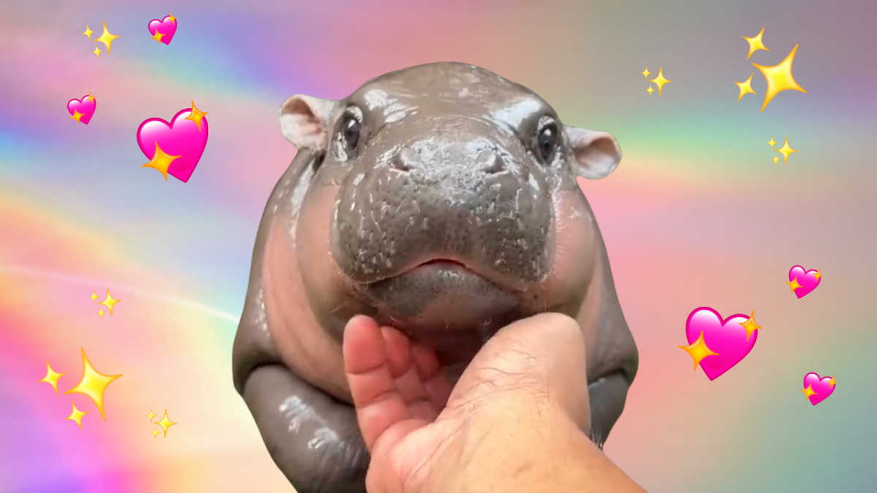
ambers@atnitribes.org
971.678.9721

