Slide 1
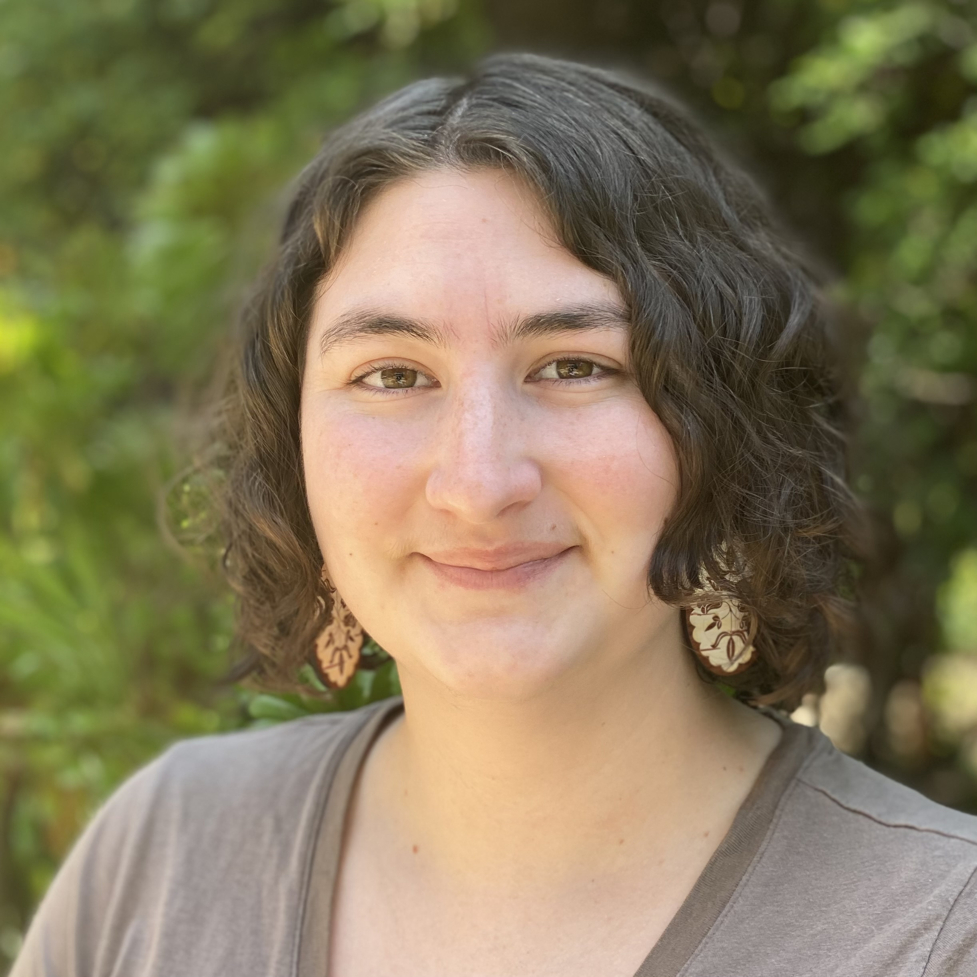
Climate Program Update
Kylie Avery
kavery@atnitribes.org
Patrick Freeland
patrickfreeland@atnitribes.org

Slide 2
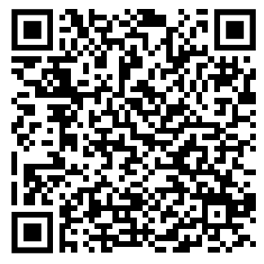
COOPERATIVE AGREEMENT & DOI RESOURCES
ATNI/BIA/USGS Cooperative Agreement will Continue
NEW DOI INDIGENOUS KNOWLEDGE HANDBOOK
BIA Branch of Tribal Community Resilience:
Northwest and Rocky Mountains Region: Matthew Laramie Matthew.Laramie@bia.gov
Alaska Region: Jennifer Robinnette Jennifer.Robinette@bia.gov
Pacific Region: Elisha Flores Elisha.Flores@bia.gov
Notes:
We are pleased to announce that the cooperative agreement between the Affiliated Tribes of Northwest Indians (ATNI), the Bureau of Indian Affairs' (BIA), and the United States Geological Survey (USGS) will continue its operations [through October 2026], supported by secured forward funding. The ATNI Tribal Climate Liaisons remain dedicated to serving Tribes throughout the Pacific Northwest region.
The US Department of the Interior has recently published the handbook, "Procedures for the Inclusion and Application of Indigenous Knowledge." This document serves multiple purposes: it works in concert with existing uniform guidance for Tribal consultation while establishing a comprehensive framework for the meaningful incorporation of Indigenous Knowledge systems within the Department's operations and research activities.
The handbook represents a structured approach to ensuring that Indigenous Knowledge receives proper recognition and application throughout the Department of the Interior's decision-making processes. This framework demonstrates the Department's commitment to elevating and integrating Indigenous Knowledge Systems (IKS) alongside other forms of evidence and expertise in departmental actions.
For those interested in reviewing the complete handbook or seeking additional information about its implementation, please contact your regional BIA office or ATNI Tribal Climate Liaisons.
We also want to inform you that the BIA Tribal Climate Resilience (TCR) program has been renamed to the Tribal Community Resilience program. TCR has provided technical and financial support to Tribes and Tribal organizations and funded over 280 Tribal adaptation plans, vulnerability assessments, and risk assessments. For inquiries regarding TCR funding opportunities, please contact your respective BIA-TCR Regional Coordinators:
Northwest and Rocky Mountains Region: Matthew Laramie Matthew.Laramie@bia.gov
Alaska Region: Jennifer Robinnette Jennifer.Robinette@bia.gov
Pacific Region: Elisha Flores Elisha.Flores@bia.gov

Slide 3
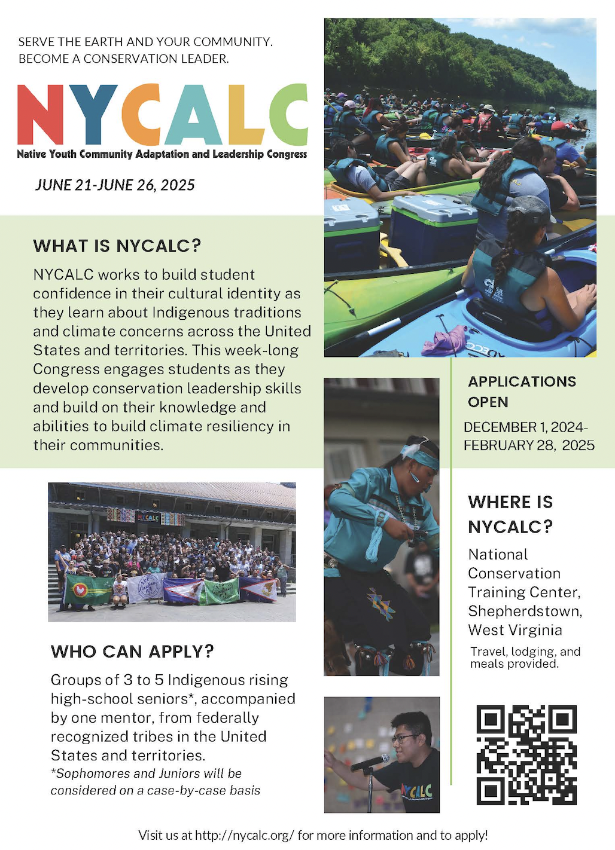
NATIVE YOUTH LEADERSHIP OPPORTUNITY
June 21-26, 2025
For more information, contact Jennifer_Hill@fws.gov or nycalc@nmwildlife.org
Visit: NYCALC.org
Applications due: February 28
Notes:
Applications are now open for the 2025 Native Youth Community Adaptation Leadership Congress (NYCALC) which brings together Native American students from across the country to address environmental changes and conservation challenges affecting Native communities. This important initiative, established through a partnership between the BIA branch of Tribal Community Resilience and the U.S. Fish and Wildlife Service, will take place from June 21-26, 2025.
Applications will be accepted through February 28th, and applications must be submitted in groups of three to five students and accompanied by a community mentor. Primary consideration will be given to rising high school seniors, with sophomores and juniors considered on a case-by-case basis. All students must be members of a federally recognized Native American Tribe or Native American based Indigenous group. Selected participants will engage in discussions about community adaptation and environmental issues directly impacting Native peoples.
For questions or additional information, please visit NYCALC.org or contact Jennifer Hill: Jennifer_Hill@fws.gov or the Program Office: nycalc@nmwildlife.org
We encourage Tribal Leaders to share this opportunity widely within their communities and to support interested Youth in applying for this valuable leadership development program!

Slide 4
STAY CONNECTED: CLIMATE ADAPTATION RESOURCES
Subscribe to ATNI Climate Resilience Newsletter!
Archived newsletters available at:
atnitribes.org/climatechange/news
Kylie Avery
kavery@atnitribes.org
Patrick Freeland
patrickfreeland@atnitribes.org
Notes:
And lastly, I would like to direct your attention to the ATNI Climate Program Newsletter included in your conference materials. This valuable resource contains current funding opportunities, information about upcoming training sessions and workshops, as well as other important news and program updates.
To stay informed of future opportunities, I encourage you to subscribe to our newsletter; links and QR codes are available on the print copy or please visit atnitribes.org/climatechange. Additionally, for more comprehensive funding opportunities and resources in the Pacific Northwest region, please explore three valuable resources: the Pacific Northwest Climate Change Network Tribal Climate Guide at tribalclimateguide.uoregon.edu/, Institute for Tribal Environmental Professional climate change resources (funding, announcements), and for Tribes in WA and puget sound area there's the Puget Sound Partnership at psp.wa.gov.
These resources, and so many more, are designed to help support your Nation’s climate adaptation and resilience initiatives and ensure you have access to the latest opportunities and information in this space. Please reach out to Patrick and Kylie.

