Slide 1
The Indian Citizenship Act of 1924

Slide 2
The Cowlitz Tribe sent Frank Iyall to Washington, D.C.

Slide 3
Annual Cowlitz General Meeting …The tribe voted to send Iyall back to Washington, D.C again, and continue pressing their claims…

Slide 4
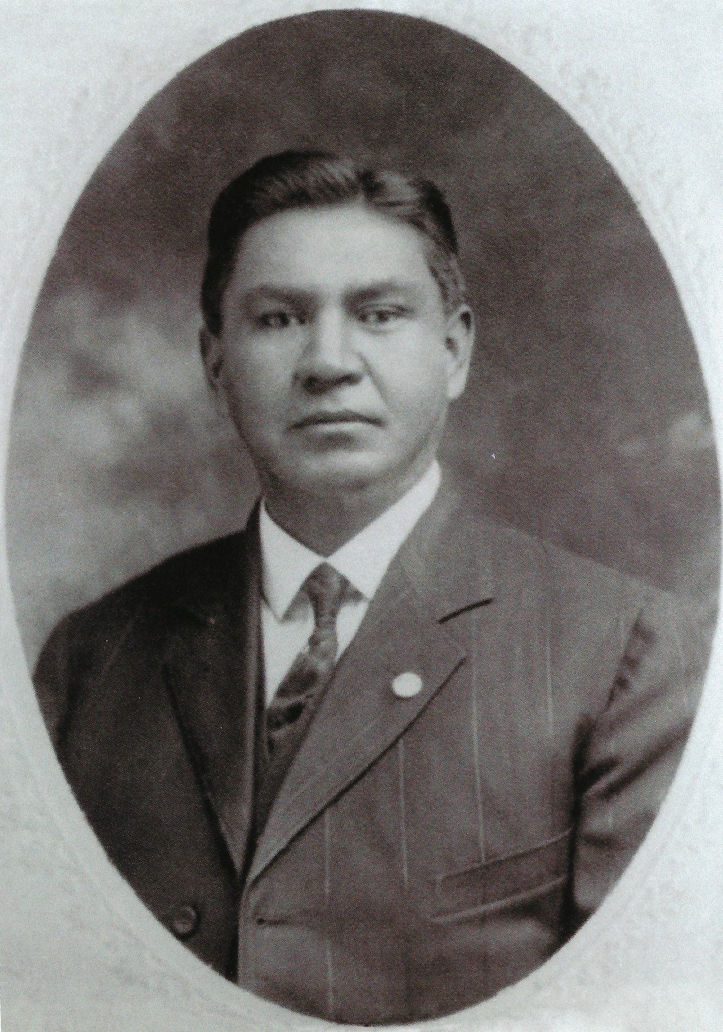
Cowlitz Tribal Delegate Frank Iyall “Frank Iyall, was a Cowlitz Tribal member who was an effective lobbyist for Indian rights in Washington, D.C. He stood up for Tribal Sovereignty rights, treaty recognition, and the Indian right to vote.”

Slide 5
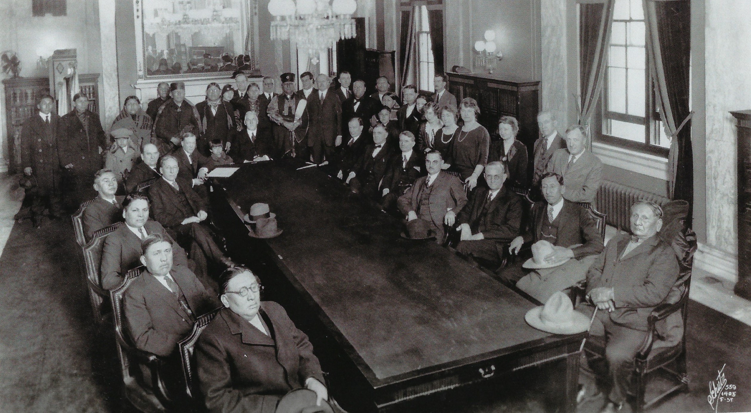
Frank (sitting 4th on the left) next to President Coolidge, with other leaders at the signing of the Indian Citizenship Act of 1924.
Frank

Slide 6
Committee on Indian Affairs December 1923

Slide 7
Frank
Frank Iyall with President Coolidge at signing of the Act.
Frank is standing 3rd from the right

Slide 8
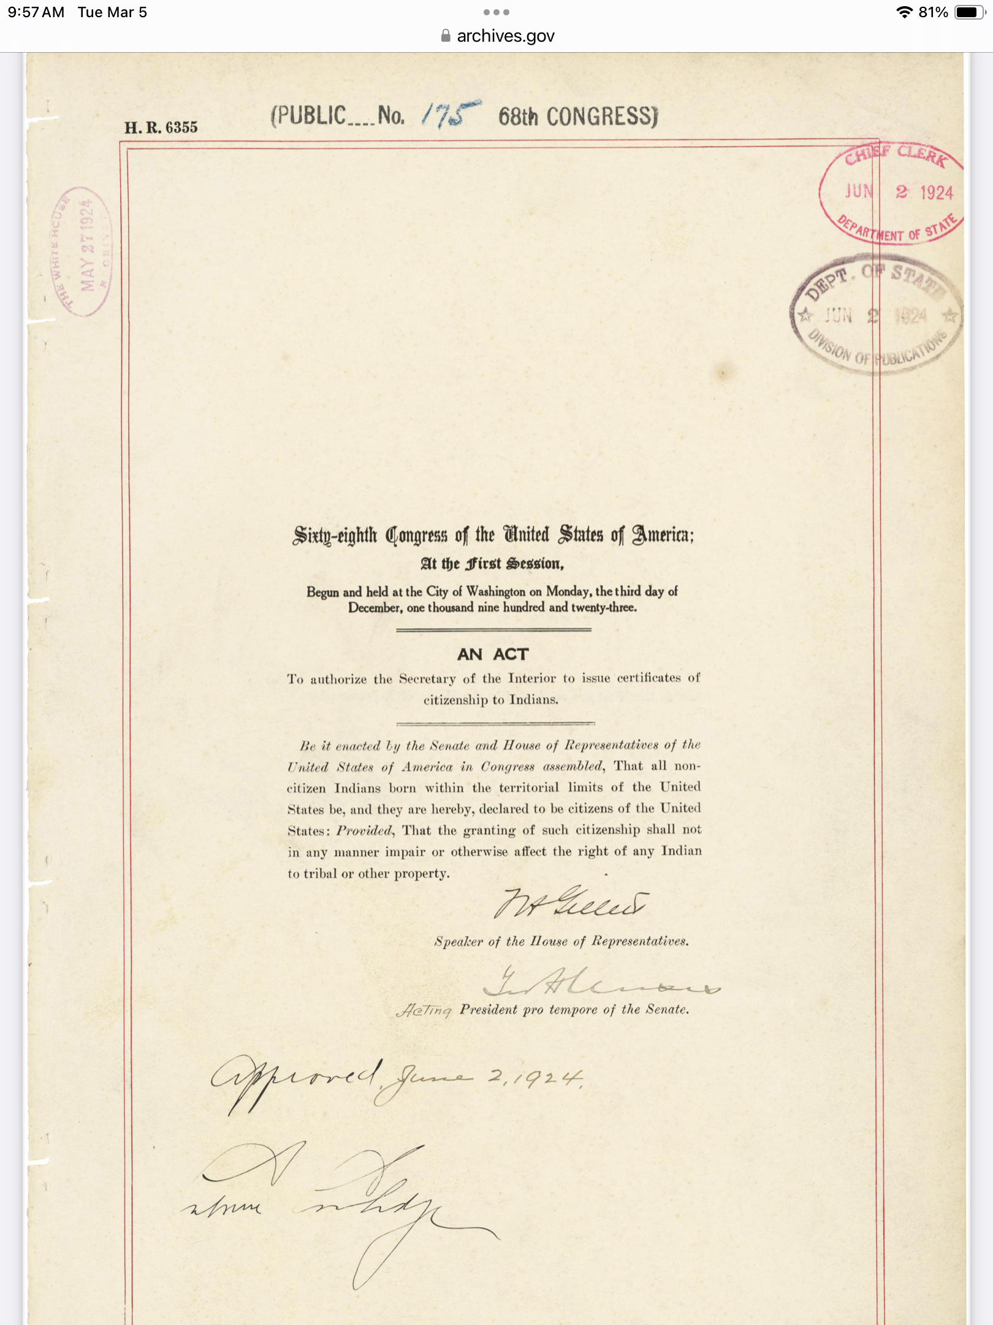
An Act to authorize the Secretary of the Interior
to issue certificates of citizenship to Indians.

Slide 9
Commemorative coin created by the U.S. Mint

Slide 10
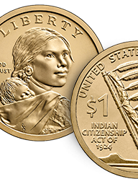
2024 Native American $1 Coin in Commemoration of the Indian Citizenship Act of 1924
On June 2, 1924, the Indian Citizenship Act was signed into law, granting U.S. citizenship to “all non-citizen Indians born within the territorial limits of the United States.” The Act notably did not require American Indians to give up their tribal citizenship to become U.S. citizens, allowing individual Indian people to preserve their tribal identity and their right to communal tribal property.
The obverse (heads) design is a portrait of
Sacagawea carrying her infant son Jean-Baptiste.
The reverse (tails) design shows an eagle staff,
an American Indian Symbol of respect, honor,
and patriotism, together with an American flag
to represent the dual citizenship of Native Americans.

Slide 11
The text of the Indian Citizenship Act of 1924, signed into law by President Calvin Coolidge on June 2,1924 reads as follows: Be it enacted by the Senate and House of Representatives of the United States of America in Congress assembled, That all non citizen Indians born within the territorial limits of the United States be, and they are hereby, declared to be citizens of the United States: Provided That the granting of such citizenship shall not in any manner impair or otherwise affect the right of any Indian to tribal or other property.

